Slide 1
North Dakota Highway Patrol App
Jackie Darr- NDHP Permits

Slide 2
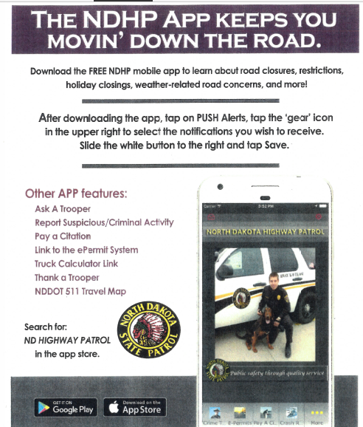

Slide 3
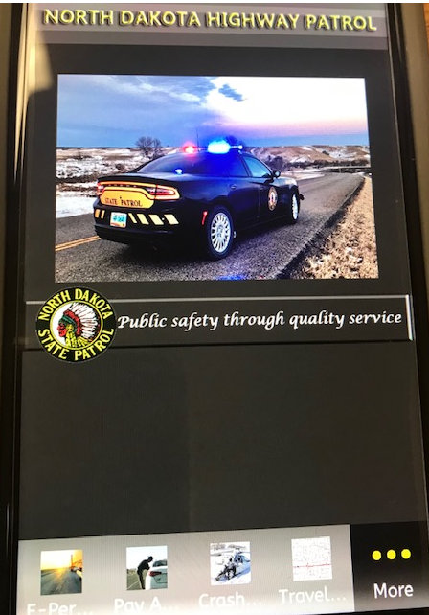
Get Push Alerts

Slide 4
What does NDHP Permits Push to Industry
No Oversize Due to Weather
Holiday Closings Order Permits Early w/Restrictions
Updates to Laws, Policies, Admin Rules
Training Classes
Computer System Changes

