Slide 1
Shifting Focus and Resources WASHTO 2019

Slide 2
SHIFT IN RESOURCES

Slide 3
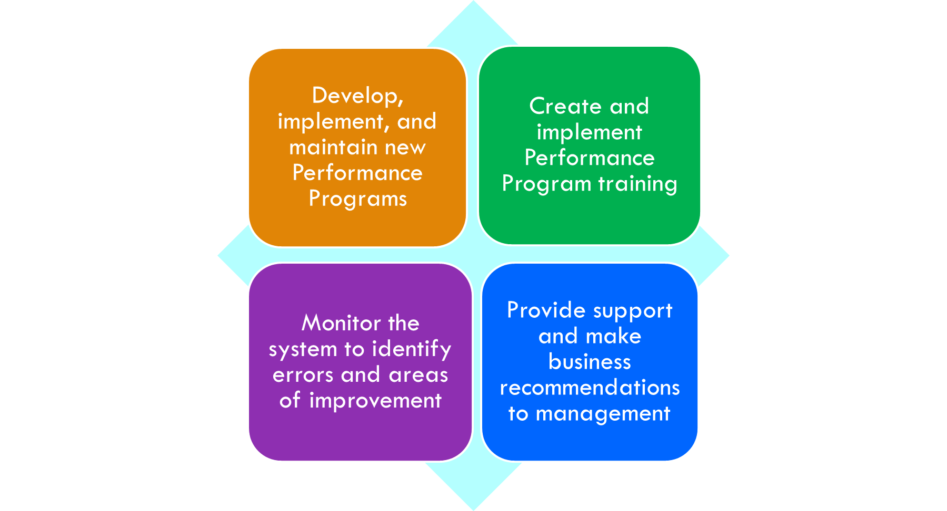
SHIFT IN RESOURCES
Product
Quality &
Analytics
Team
Mission:

Slide 4
SHIFT IN RESOURCES
The Quality team worked with management to develop new Performance Programs and performance metrics for consistency across all teams.
Permit Quality
Phone Quality
Reliability/Schedule Management
Productivity

Slide 5
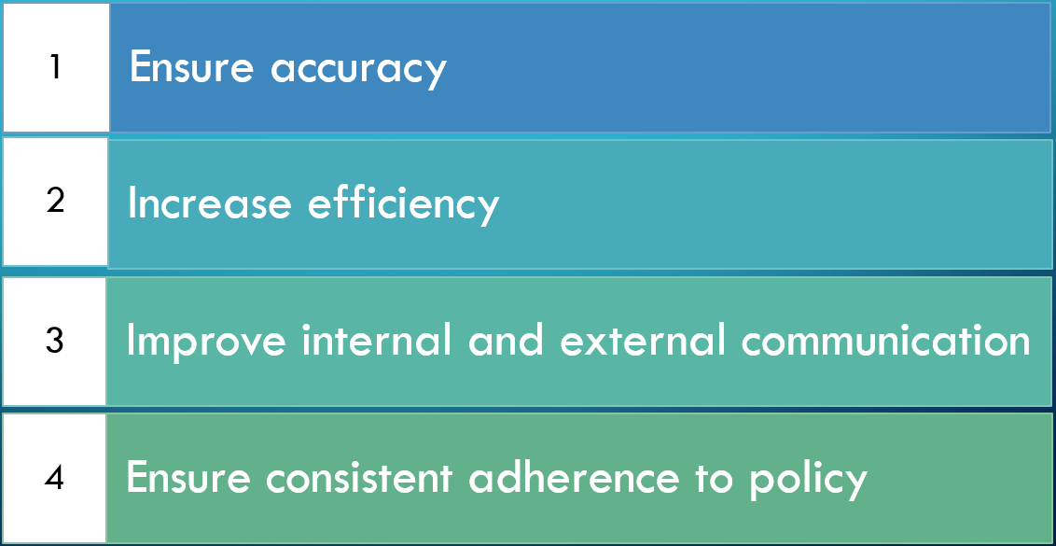
SHIFT IN RESOURCES
Permit Quality

Slide 6
SHIFT IN RESOURCES
Phone Quality

Slide 7
SHIFT IN RESOURCES
Personal Accountability

Slide 8
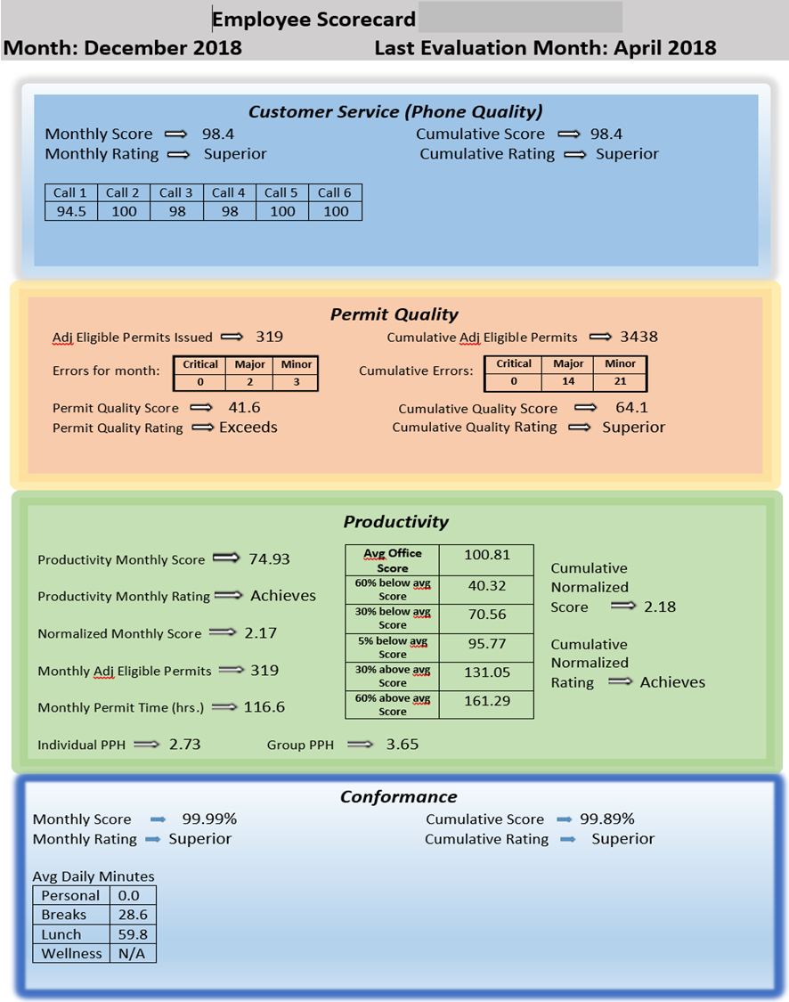
SHIFT IN RESOURCES
Performance
Performance data is provided to supervisors on a daily basis and is also quantified monthly in the form of an Employee Scorecard.
Quarterly meetings are held to discuss the program’s progress.

Slide 9
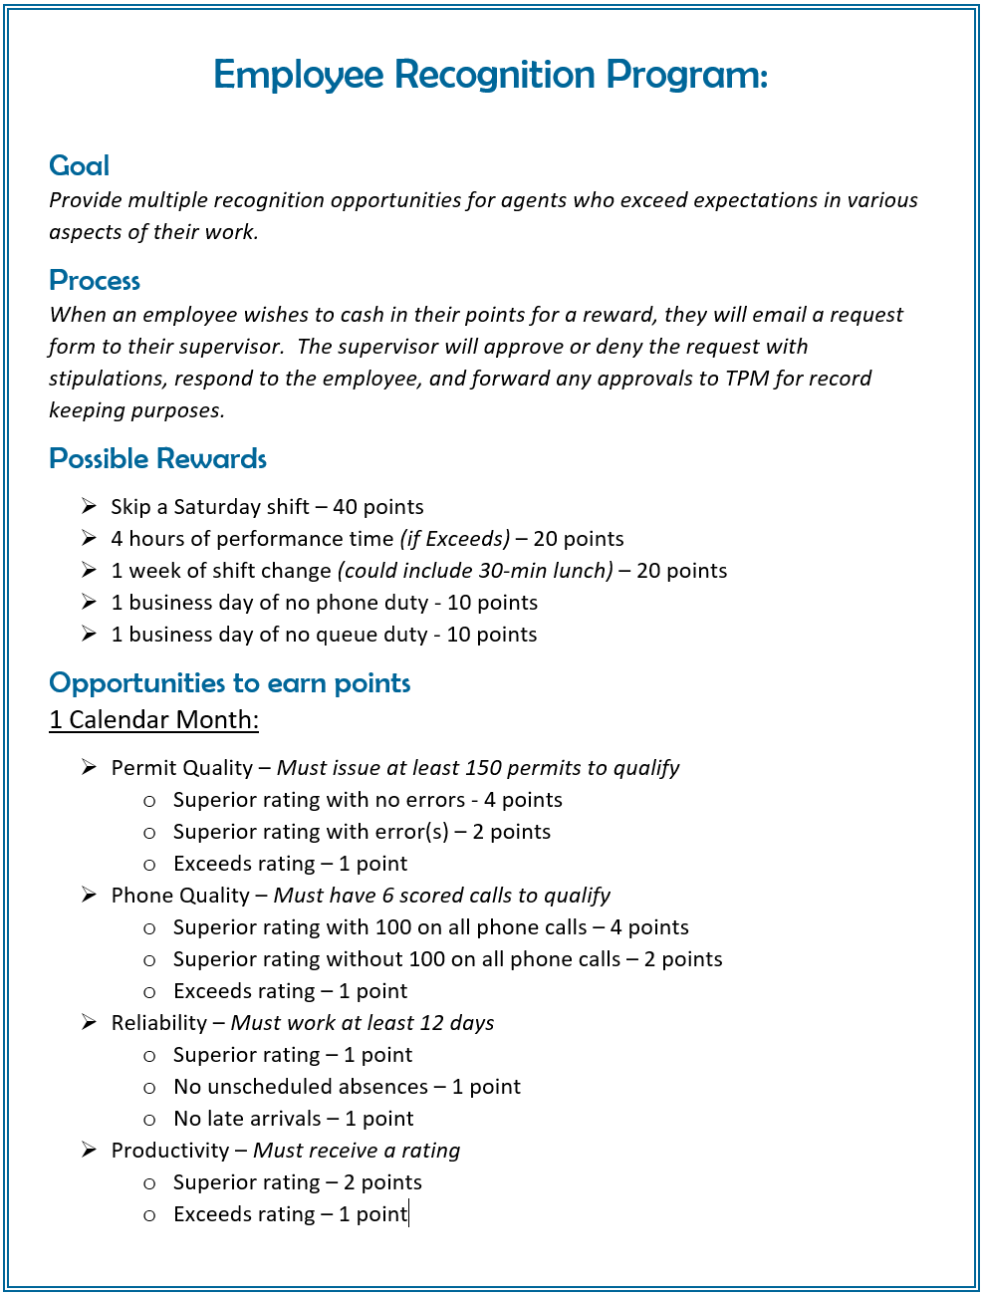
SHIFT IN RESOURCES
Employee Recognition Program
As an incentive, employees who exceed expectations in these performance categories earn points that compound and can be turned in for rewards including paid time off.

Slide 10
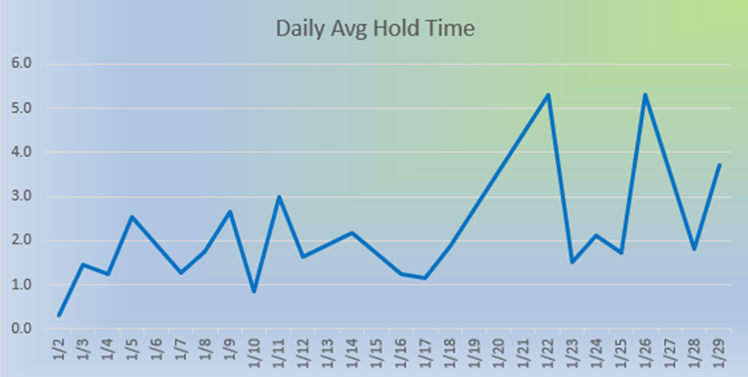
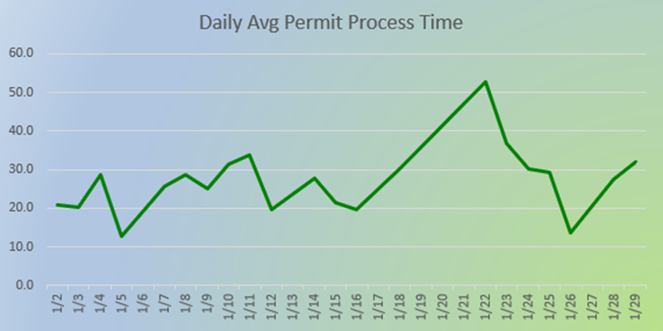
SHIFT IN RESOURCES
Monthly Reporting
Business Trends
Permit Type
Industry Code
Statics
# of Permits Issued
Average Processing Time
# of Phone Calls
Average Call Hold Time

Slide 11
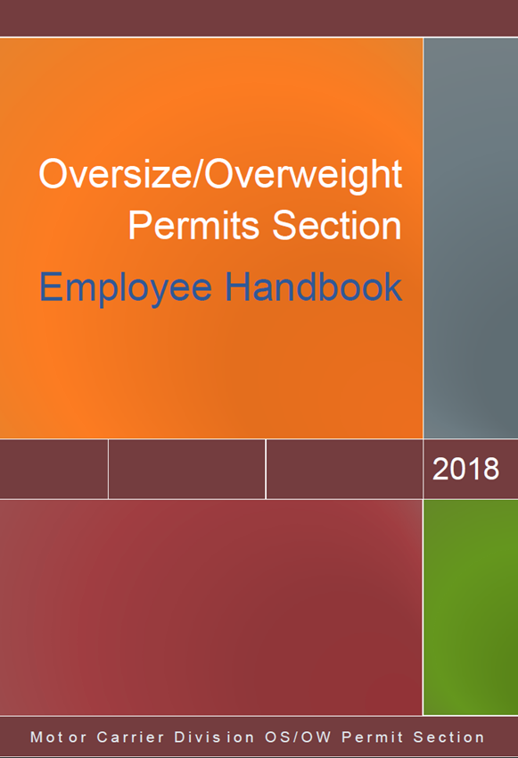
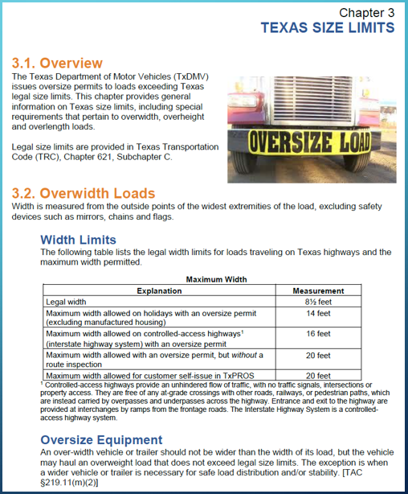
RESOURCE DEVELOPMENT
Ongoing updates of resources: Employee Handbook

Slide 12
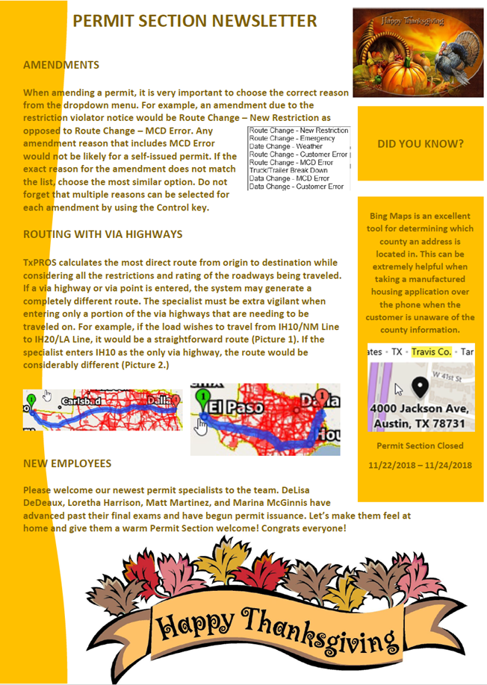
RESOURCE DEVELOPMENT
Creation and distribution of monthly newsletters

Slide 13
SHIFT IN RESOURCES: TRAINING
Customer Training
Creation and maintenance of tutorials on the TxDMV website
Agent training opportunities focused on different aspects of customer service
Communication skills
Knowledge of law and policy
Ability to troubleshoot
Professionalism and courtesy
Efficiency

Slide 14
SHIFT IN RESOURCES
Intra-Office Support
The Quality team initiates communication with management to develop and amend policies

Slide 15
SHIFT IN RESOURCES
Intra-Office Support

Slide 16
SHIFT IN RESOURCES
Questions?

