Slide 1
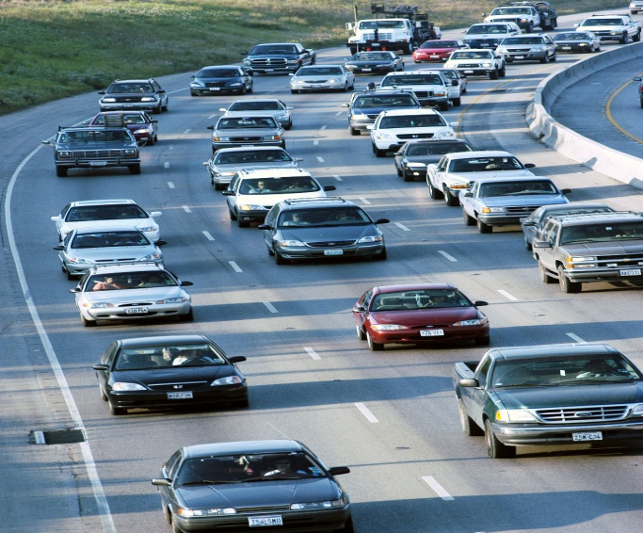
SUPER HEAVY REVIEW PROCESS in Texas
TxDOT Bridge Management Program
February 20, 2019
Notes:
Welcome message: Discuss how the super heavy review is part of the management of assesses in Texas. Stress the importance of this.

Slide 2
Table of Contents
1
Texas Bridge Facts
2
Texas Department of Motor Vehicles (TxDMV) – Motor Carrier Division
3
Permit Process for Super Heavy
4
Texas Department of Transportation (TxDOT) – Bridge Division
5
Bridge Evaluation
6
Restrictions
Notes:
Intro of the content of the presentation.

Slide 3
Table of Contents
1
Texas Bridge Facts
2
Texas Department of Motor Vehicles (TxDMV) – Motor Carrier Division
3
Permit Process for Super Heavy
4
Texas Department of Transportation (TxDOT) – Bridge Division
5
Bridge Evaluation
6
Restrictions
Notes:
Start off with Texas bridge facts to stress the size of the system. We actually have a streamlined process considering the size of the bridge inventory.

Slide 4
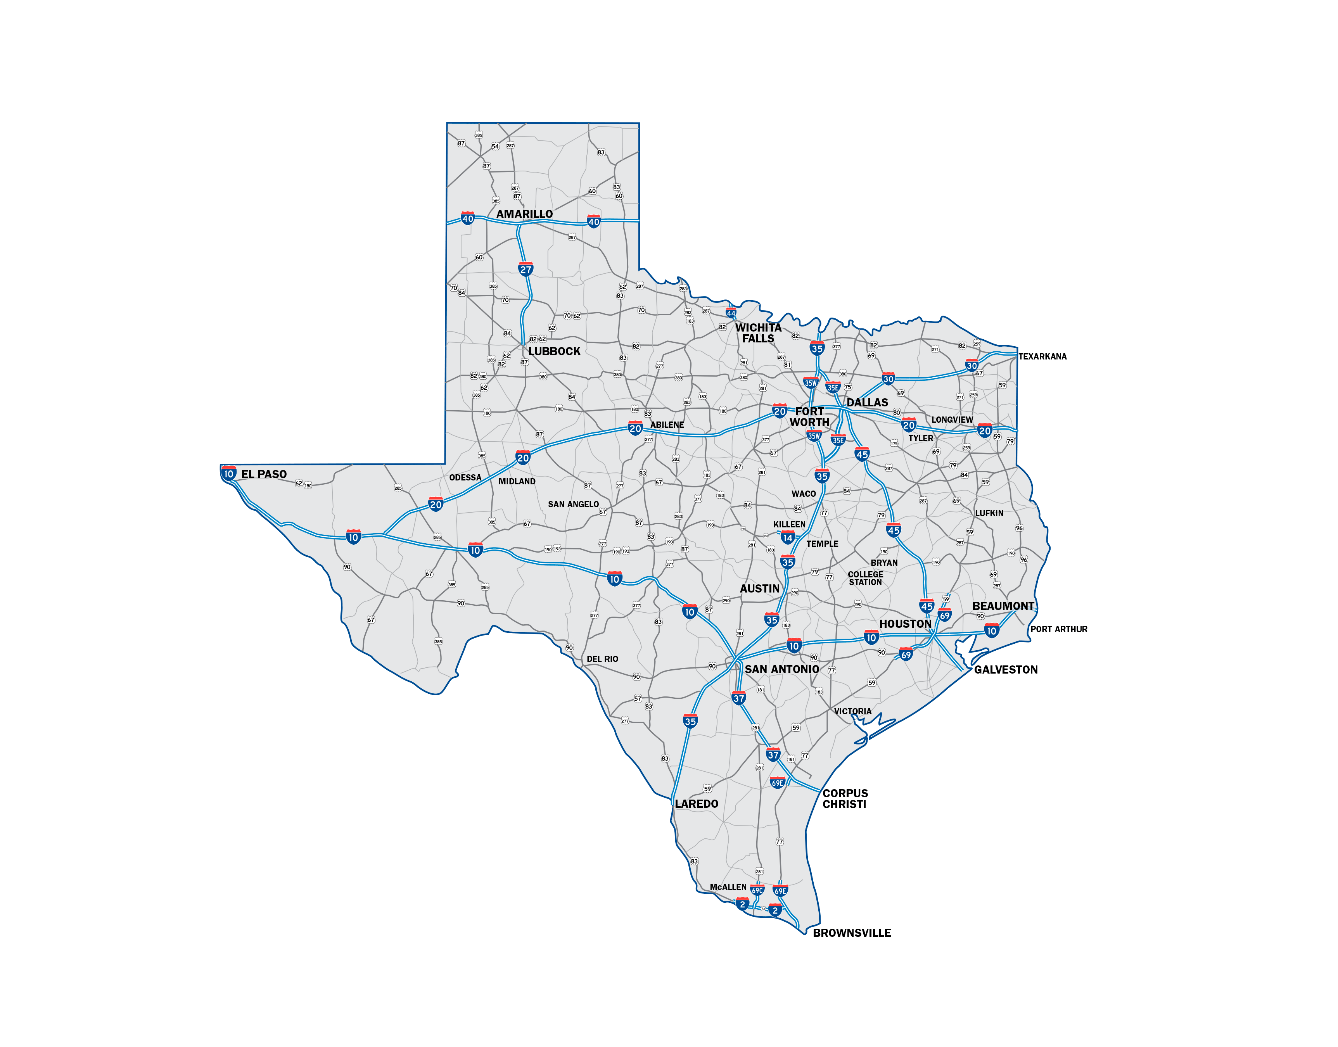
Texas Highway System

Slide 5
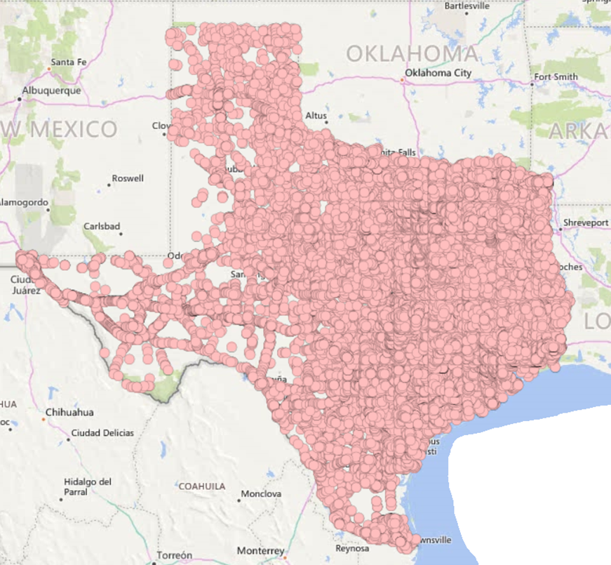
Texas Bridge Facts
Notes:
Screenshot of Map of Texas bridges, on and off system.

Slide 6
Texas Bridge Facts
Texas has 54,180 bridges that carry vehicular traffic‐‐about 26,000 more bridges than any other state in the nation, and more than the combined inventories of 17 states.
35,564 Texas bridges are on the state system, and 18,616 bridges are off the state system (city streets, county roads, etc.)
The average age of Texas bridges is 42 years.
88.8 percent of all on‐system bridges are in good or better condition.
Data as of January 2018
http://ftp.dot.state.tx.us/pub/txdot-info/library/pubs/bus/bridge/facts-17.pdf
Notes:
stats

Slide 7
Texas Bridge Facts
2018 On System Bridge Inventory
(13,700)
Notes:
Breakdown of types of bridges and age of the inventory. Stress that the age of the inventory.

Slide 8
Table of Contents
1
Texas Bridge Facts
2
Texas Department of Motor Vehicles (TxDMV) – Motor Carrier Division
3
Permit Process for Super Heavy
4
Texas Department of Transportation (TxDOT) – Bridge Division
5
Bridge Evaluation
6
Restrictions
Notes:
Discussion of TxDMV starts

Slide 9
Role of TxDMV – Motor Carrier Division
Issues permits and route for oversize/overweight
Receives the application for oversize/overweight permits
The TxDMV maintains a master set of maps showing the various width, height, and load limitations on all highways.
Permits for Super Heavy are issued by TxDMV
https://www.txdmv.gov/motor-carriers/oversize-overweight-permits
Notes:
Functions of TxDMV in the Super Heavy process. Requirements for the definition of types of loads is controlled by Texas Administrative Code.

Slide 10
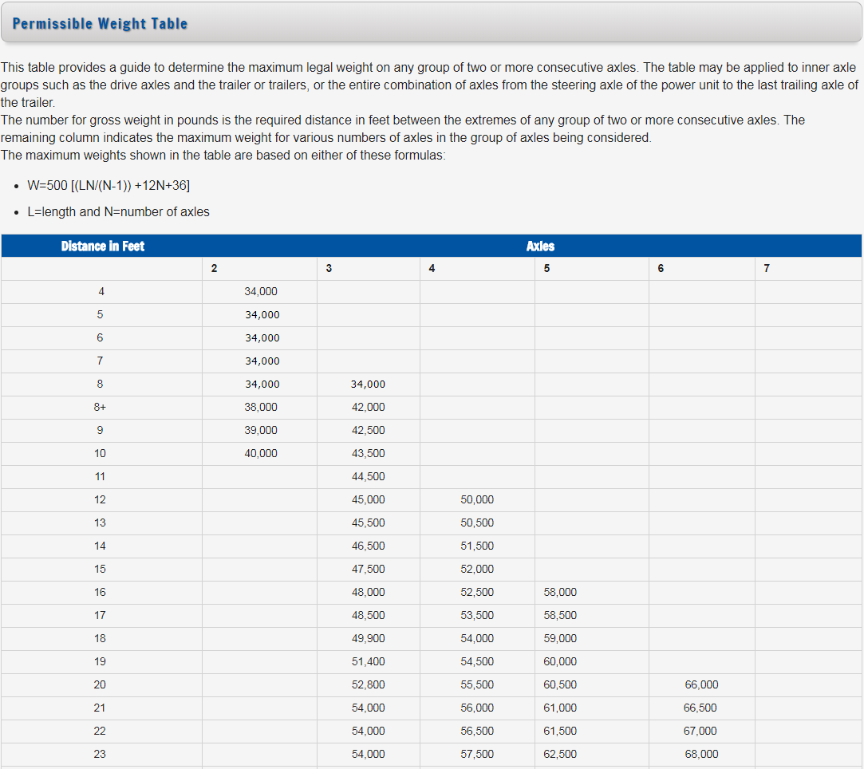
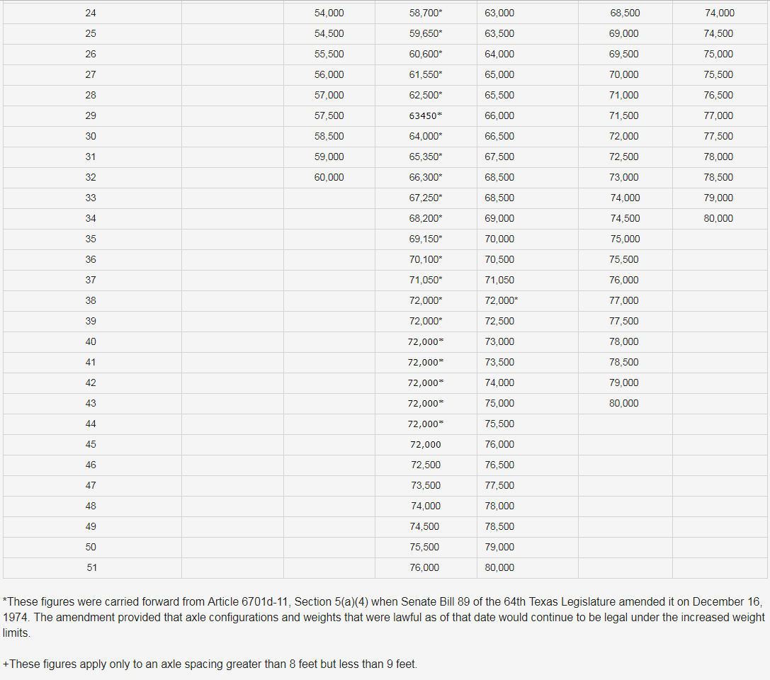
Permissible Weight Table
https://www.txdmv.gov/component/k2/item/2123-permissible-weight-table
Notes:
Here is the permissible weight table from the Texas Administrative code.
It incorporates a correlation of axle spacing versus gross axle weight.
A transportation firm will look to this table to determine whether they need a permit to move a particular load.

Slide 11
Table of Contents
1
Texas Bridge Facts
2
Texas Department of Motor Vehicles (TxDMV) – Motor Carrier Division
3
Permit Process for Super Heavy
4
Texas Department of Transportation (TxDOT) – Bridge Division
5
Bridge Evaluation
6
Restrictions
Notes:
Start of the review process.

Slide 12
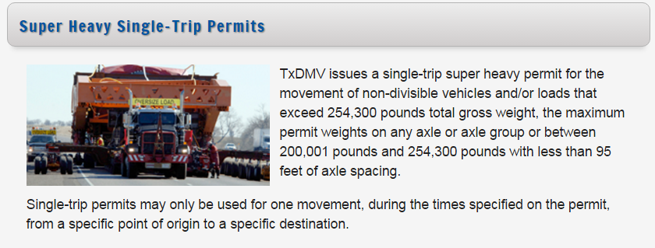
Definition of a Super Heavy Load in Texas
Exceeds 254,300 lbs (gross vehicle weight)
Exceeds maximum permitted weight on any axle group
Exceeds 200,000 lbs with less than 95 feet total axle spacing
http://www.txdmv.gov/oversize-weight-permits/super-heavy-single-trip
Notes:
Definition of Super Heavy load in Texas.

Slide 13
Permit Process
TxDMV receives
application
TxDMV creates
route
TxDMV Permit issued
TxDOT District review
BRG sends letter of approval
TxDMV sends proposed route to carrier
Analysis sent to BRG for review
Consulting engineer performs bridge analysis
Notes:
First Steps involving TxDMV.

Slide 14
Super Heavy Permit Application Requirements
Applications and supporting documentation must be sent six to eight weeks before the permit is required, unless an existing pre-approved route is on file.
Carriers must review permit for specific conditions that apply to the load and movement.
Super Heavy permits require coordination with TxDOT Districts to determine route suitability or to facilitate movement of the load.
Notes:
How to submit and application. Where to find the requirements. Requirements are set to determine the appropriate route.

Slide 15
Permit Process
TxDMV receives
application
TxDMV creates
route
TxDMV Permit issued
TxDOT District review
BRG sends letter of approval
TxDMV sends proposed route to carrier
Analysis sent to BRG for review
Consulting engineer performs bridge analysis
Notes:
Show next step in the process, after route has been determined. The route must go to TxDOT Districts.

Slide 16
TxDOT Districts
TxDOT is comprised of 25 Districts.
District Permit Officer assists the TxDMV in the evaluation of over-height and over-width permit routes.
TxDOT Districts understand local conditions that can vary day to day.
TxDOT District Bridge Coordinators ensure that bridge conditions are input into bridge management database.
Proposed route is created
AMARILLO
CHILDRESS
WICHITA FALLS
PARIS
LUBBOCK
FORT WORTH
DALLAS
ATLANTA
EL PASO
ABILENE
TYLER
BROWNWOOD
LUFKIN
ODESSA
WACO
SAN ANGELO
BRYAN
AUSTIN
BEAUMONT
SAN ANTONIO
HOUSTON
YOAKUM
LAREDO
CORPUS
CHRISTI
PHARR
Notes:
Discuss the makeup of TxDOT Districts and the importance of District Permit Coordinators.

Slide 17
Permit Process
TxDMV receives
application
TxDMV creates
route
TxDMV Permit issued
TxDOT District review
BRG sends letter of approval
TxDMV sends proposed route to carrier
Analysis sent to BRG for review
Consulting engineer performs bridge analysis
Notes:
After the review of the route by the TxDOT District and District permit coordinators.

Slide 18
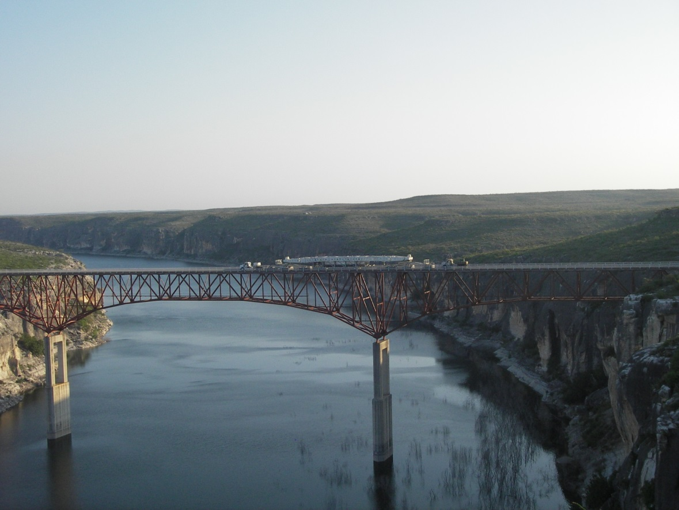
Consultant Bridge Analysis
Commercial movers must provide an analysis of bridges on the proposed route.
A superheavy engineering report must be provided to TxDOT BRG for review.
These reports are generally prepared by third-party consulting engineers that are pre-approved by TxDOT BRG for overweight route analysis.

Slide 19
Table of Contents
1
Texas Bridge Facts
2
Texas Department of Motor Vehicles (TxDMV) – Motor Carrier Division
3
Permit Process for Superheavy
4
Texas Department of Transportation (TxDOT) – Bridge Division
5
Bridge Evaluation
6
Restrictions

Slide 20
TxDOT – Bridge Division
TxDOT Bridge Division (BRG) oversees the management of the State bridge inventory
Superheavy permits must be coordinated with BRG for review of the consulting engineers structural evaluation of select bridges on a proposed route.
BRG recommendations sent to TxDMV
AMARILLO
CHILDRESS
WICHITA FALLS
PARIS
LUBBOCK
FORT WORTH
DALLAS
ATLANTA
EL PASO
ABILENE
TYLER
BROWNWOOD
LUFKIN
ODESSA
WACO
SAN ANGELO
BRYAN
AUSTIN
AUSTIN
BEAUMONT
SAN ANTONIO
HOUSTON
YOAKUM
LAREDO
CORPUS
CHRISTI
PHARR
Notes:
Importance of the assets we have in the bridge inventory.

Slide 21
Table of Contents
1
Texas Bridge Facts
2
Texas Department of Motor Vehicles (TxDMV) – Motor Carrier Division
3
Permit Process for Superheavy
4
Texas Department of Transportation (TxDOT) – Bridge Division
5
Bridge Evaluation
6
Restrictions

Slide 22
Summary of Evaluation Process
Evaluate Vehicle
Determine selection of bridges to analyze
Determine distribution factors
Perform structural analysis
Generate report
Notes:
We have a pretty good idea which bridges are going most sensitive to the overload. Our goal is to find a route in which all the bridges will pass the vehicle. Over time of course, we have identified certain corridors that work for transporting super heavy loads. Some of the bridge types that historically have needed to be analyzed are:
Continuous and cantilever steel I-beams and steel plate girder bridges.
Continuous reinforced concrete bridges.
Continuous for live load prestressed concrete girder bridges.
Some prestressed concrete U-beam bridges.

Slide 23
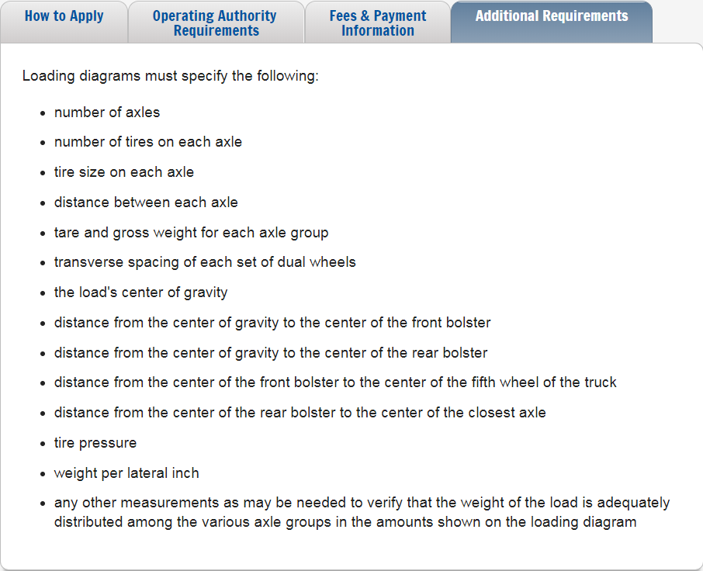
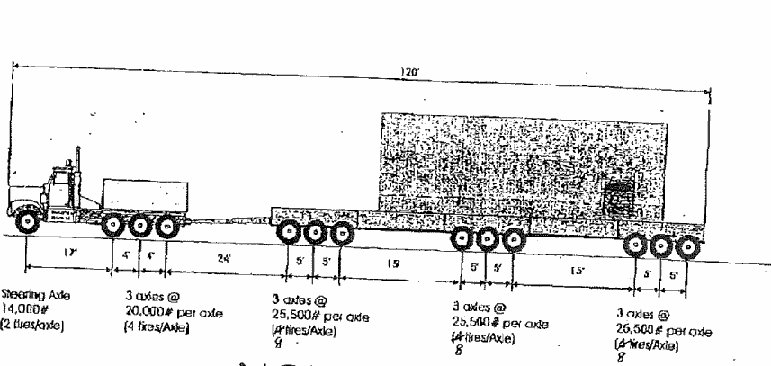
Loading Diagram
Tire pressure and weight per lateral inch are not required on the loading diagram, unless otherwise directed
Loading diagram is needed to analyze structures on the route
Notes:
As part of the application process a loading diagram is needed to evaluate bridges on the proposed route.

Slide 24
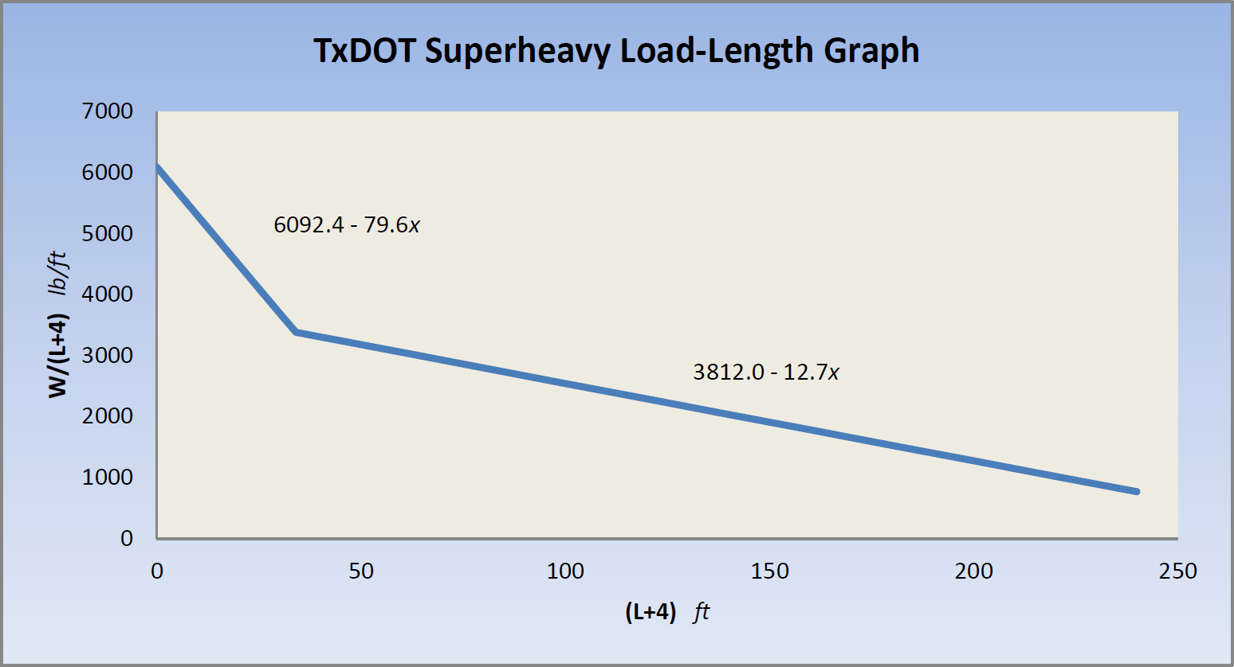
Evaluate the Vehicle
“Panak Curve” developed by John Panak, P.E. in the 1990s.
Simple method to determine the type of bridges to analyze based on vehicle.
Perform evaluation for each group of axles and compare to values in table or plot on “Panak Curve.”
Notes:
A method for graphically charting the harshness of a super heavy vehicle. It can be used to identify those vehicles whose combination of gross weight and load distribution MAY cause problems. It is an identification tool and is not used in the final analysis.
It was developed for simple spans, but the trend can be applied to any bridge. The implication is that if your data points lie underneath the curve, the load is relatively benign and stresses in the structure will remain within the operational envelope. If some of the data points for a particular trailer configuration lie above the curve, it would indicate that analysis of suspect bridges on the route would be prudent.
The curve itself was developed by plotting points for then current permit groups, specific overloads studied on various H15 bridges, 58,000 pound tandems and 66,000 pound triples; and then fitting a “best” curve through the data. This curve was then compared to plots of large cranes that John felt were stressing the bridges. Their points were well above the developed curve.

Slide 25
Bridge Evaluation
Why do we evaluate certain bridges?
Older bridges were designed to much lighter loads
Bridge condition
Extend the design life of bridges
Management of bridge assets
Notes:
Go into the actual analysis and the purpose of the analysis.

Slide 26
Types of Bridges to Analyze
Continuous and cantilever steel I-beam and plate girder bridges
Continuous reinforced concrete bridges
Continuous for live load prestressed concrete girder bridges
Older prestressed concrete U-beam bridges
Continuous flat slab bridges
Notes:
We have a pretty good idea which bridges are going most sensitive to the overload. Our goal is to find a route in which all the bridges will pass the vehicle. Over time of course, we have identified certain corridors that work for transporting super heavy loads. Some of the bridge types that historically have needed to be analyzed are:
Continuous and cantilever steel I-beams and steel plate girder bridges.
Continuous reinforced concrete bridges.
Continuous for live load prestressed concrete girder bridges.
Some prestressed concrete U-beam bridges.

Slide 27
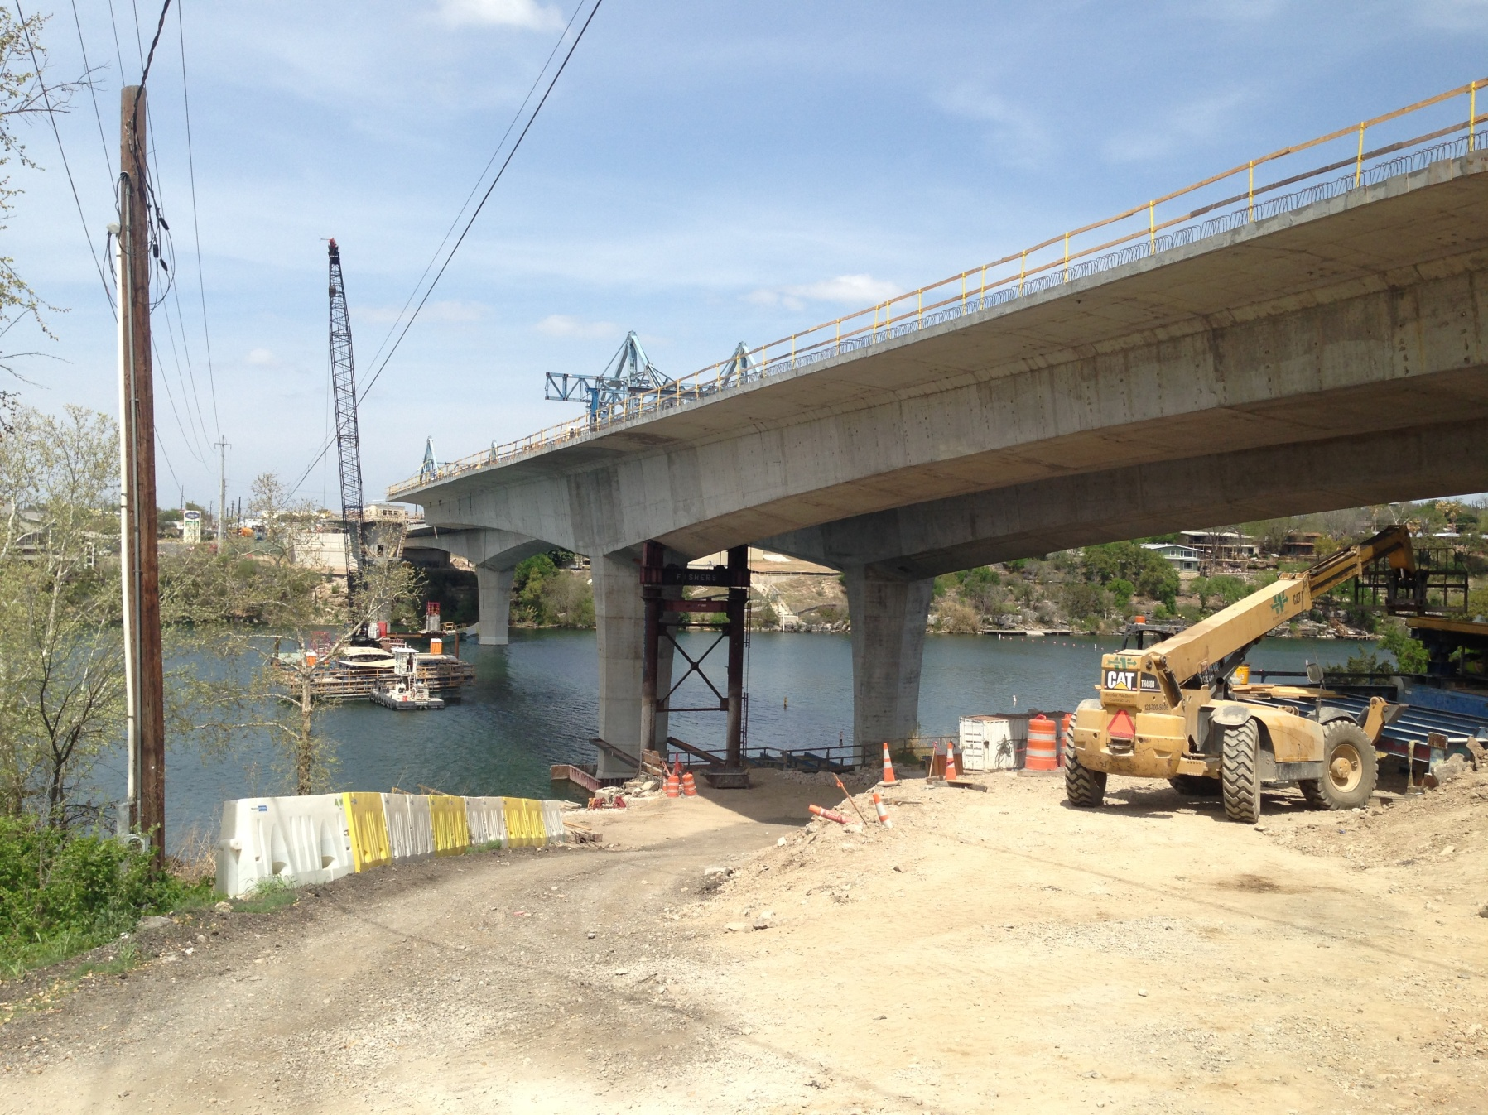
Types of Bridges to Analyze
Specialty bridges such as trusses, suspension, concrete segmental and cable-stayed bridges
Bridges with a condition rating below a specified threshold
Foundations susceptible to erosion
Concrete Segmental Bridge
Notes:
Stress how condition is important. Conditions can change.

Slide 28
Bridge Components Analyzed
Notes:
Overview of the components that are analyzed.

Slide 29
Bridge Components Analyzed
Superstructure flexure
Shear in certain cases

Slide 30
Bridge Components Analyzed
Substructure

Slide 31
Bridge Components Analyzed
Foundations (scour)
Notes:
Stress the importance of scour and how this can change. We have a system in place to track scour with our inspections. A record of scour critical bridges is kept.

Slide 32
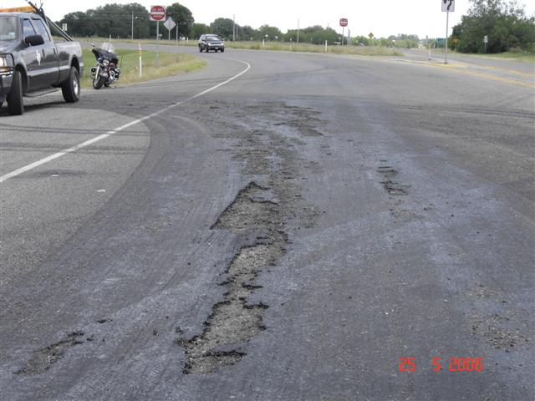
Culverts and Pavement
Culverts not usually analyzed
Pavement parametric study done using TxDOT Pavement Section’s requirements
Notes:
As benign as we try to make them, these vehicles are very heavy and can cause damage. New seal coats are particularly vulnerable.

Slide 33
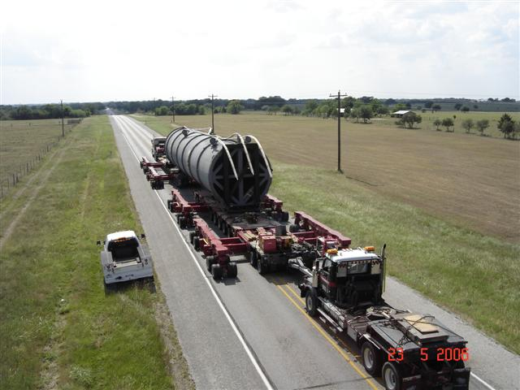
Load Distribution
Notes:
One of the most important parts of the analysis is lateral load distribution. AASHTO and the Manual for Bridge Evaluation gives us direction for this.

Slide 34
Load Distribution
P
P
Notes:
Beam reactions are based on the distribution of the load. Animation shows the very concentrated load. Show the reaction of the beams. Distribution of load determines load factors.

Slide 35
Load Distribution
P
P
P
P
Notes:
Same as before but the load is distributed over a larger area.

Slide 36
Load Distribution
Flexure continuous superstructure
Short span
Long span

Slide 37
Load Distribution
Flexure continuous superstructure
Load distributed over single span

Slide 38
Load Distribution
Flexure continuous superstructure
Load distributed over multiple spans

Slide 39
Load Distribution
Flexure simple span superstructure
Notes:
The goal of an LRFD analysis is to identify a rating factor for the bridge, which is the rating factor of it’s weakest member when subjected to the overload. In essence, this rating factor is the ratio of live load capacity divided by the live load demand.
Obviously, we would like this number to be over 1. If it’s not, we have to re-route the vehicle or change it’s configuration.
Because permanent deformations are usually looked on unfavorably, we disallow the plastic moment criteria contained in the code.

Slide 40
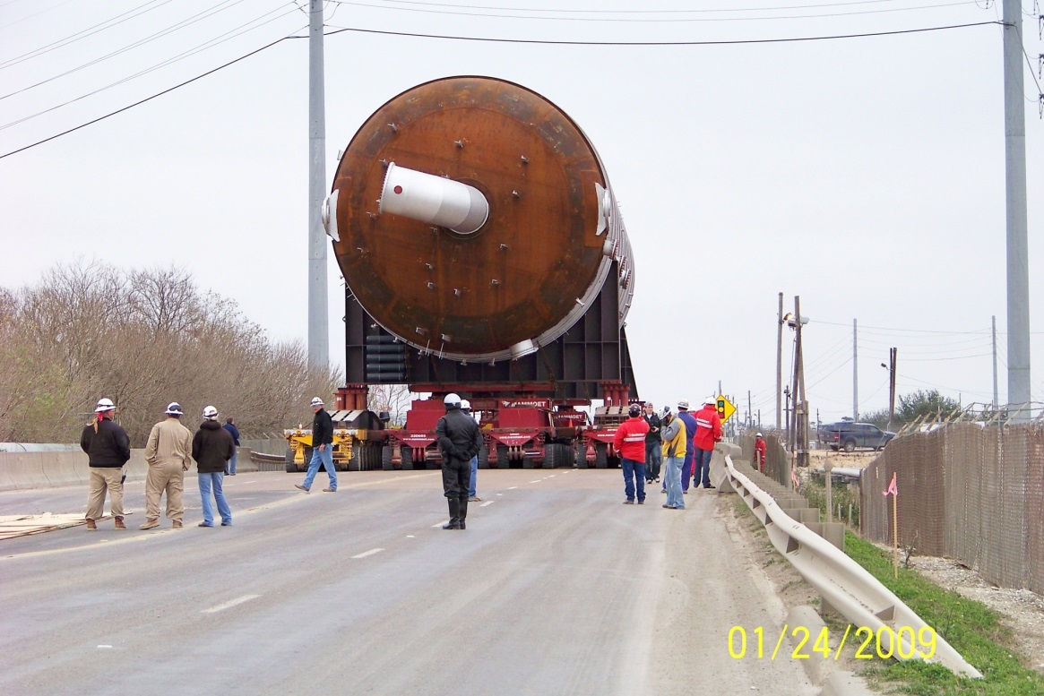
General Effects
Length of spans and placement of the load on the bridge are considerations because:
Load distribution reduces load demand.
Load placement can be controlled by current conditions of bridge elements (based on their current structural capacity).

Slide 41
General Effects
Specific analysis of structures for super heavy, is usually done with a load multiplier consistent with the restricted speed of the vehicle.
The restriction on speed can also help reduce the effects of impact loading.
Notes:
A quick and easy way to reduce the severity of an overload is to slow it down. By decreasing the speed of the vehicle, it’s tendency to bounce as it traverses deck joints and imperfections decreases, lessening the impact loading. Typical LRFD impact loading is 33% of the vehicle. Speeds under 10 mph bring that value to zero.

Slide 42
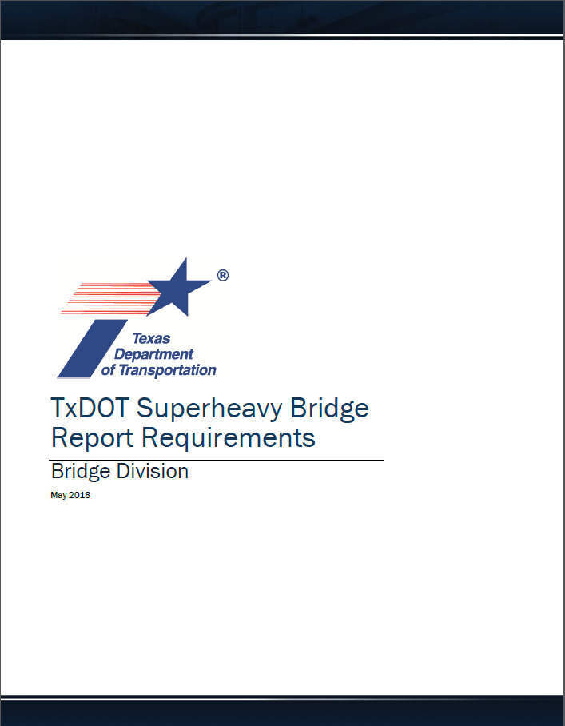
Super Heavy Report
Include hauler info, route, weight
Provide vehicle evaluation using “Panak Curve”
List all bridges analyzed and controlling stresses for flexure
Identify and discuss any suspect bridges

Slide 43
Super Heavy Report
Explain or justify load distribution assumptions
List General Restrictions
List Special Restrictions as needed for each structure
Provide weighing information
Sign or Seal and Date

Slide 44
Table of Contents
1
Texas Bridge Facts
2
Texas Department of Motor Vehicles (TxDMV)
3
Permit Process for Superheavy
4
Texas Department of Transportation (TxDOT)
5
Bridge Evaluation
6
Restrictions

Slide 45
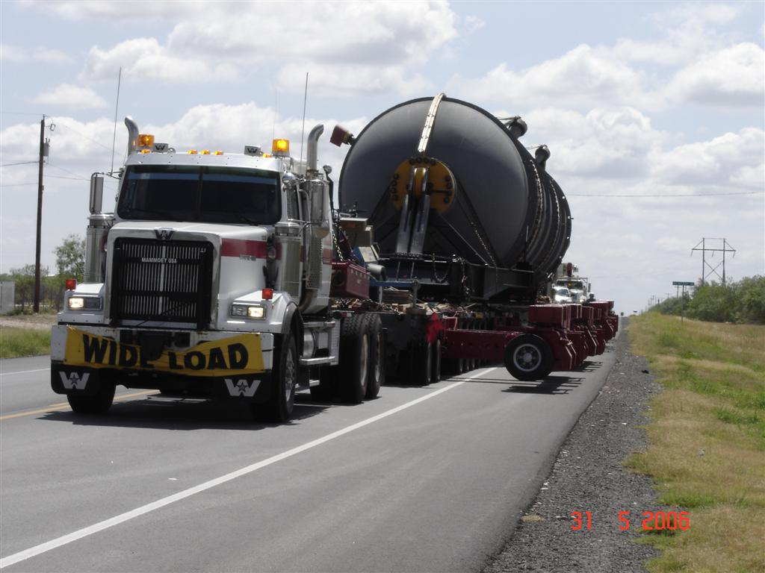
Restrictions
No other vehicles are allowed on the bridge at the same time
Require the vehicle to drive in a specified path (photo documentation required at times, some with measurement)
Reducing the speed over the bridges (reduces impact and load effects)
Dollies are acceptable and can be raised for off-bridge travel
Crabbing the vehicle is an option

Slide 46
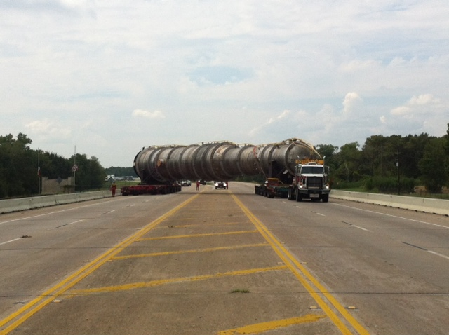
Restrictions
Vehicle Crabbed

Slide 47
Weighing
Weight tolerances are shown in the engineering report
If tolerance is exceeded a re-analysis of specified bridges is required

Slide 48
Restrictions
Have the engineering consultant witness the move to verify speed for impact effects and load positioning, required for crabbing.
Carriers must review permit for specific conditions that apply to the load and movement.
TxDOT provides restrictions to allow the load on the bridge, instead of re-route, without limiting commerce.

Slide 49
Copyright Notice
Copyright 2019 • Texas Department of Transportation • All Rights Reserved
Entities or individuals that copy and present state agency information must identify the source of the content, including the date the content was copied. Entities or individuals that copy and present state agency information on their websites must accompany that information with a statement that neither the entity or individual nor the information, as it is presented on its website, is endorsed by the State of Texas or any state agency. To protect the intellectual property of state agencies, copied information must reflect the copyright, trademark, service mark, or other intellectual property rights of the state agency whose protected information is being used by the entity or individual. Entities or individuals may not copy, reproduce, distribute, publish, or transmit, in any way this content for commercial purposes. This presentation is distributed without profit and is being made available solely for educational purposes. The use of any copyrighted material included in this presentation is intended to be a “fair use” of such material as provided for in Title 17 U.S.C. Section 107 of the U.S. Copyright Law.

