Slide 1
Permit and Automated Routing System
Presenter: Dan Kiely Celtic Systems WASHTO Committee on Highway Transport February 18, 2020 Charlotte, NC

Slide 2
Little About Us
Boutique product company focused on Motor Carrier and Motor Vehicle administrations
Deep bench strength of MVA systems, technologists and business experts
Nimble organization with lean structure and without common overheads and burdens of large organizations
Proven flexible integrated COTS Product Line and 100% implementation track record
Notes:
Logo file is resolution is not good

Slide 3
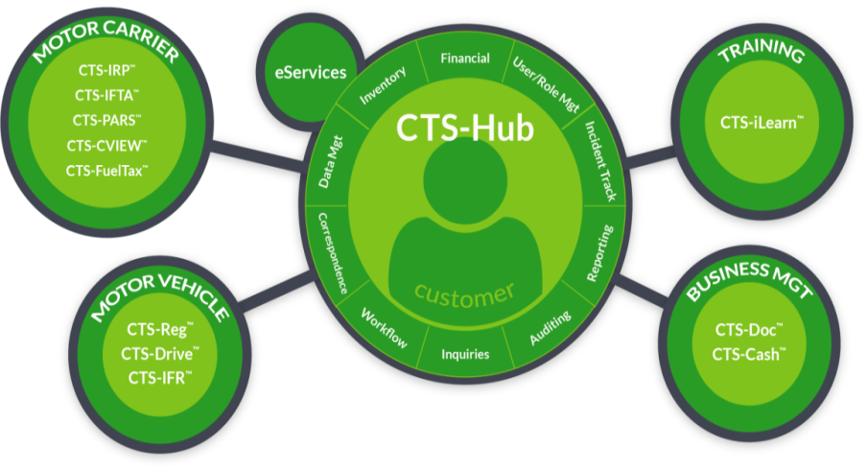
Our Products And Services

Slide 4
CTS-PARS
Permitting and Automated Routing COTS Solution (CTS-PARS)
Permitting
Routing
Restriction Management

Slide 5
CTS-PARS
Features
Leverages ESRI ArcGIS Technology and toolsets
Real-time communications capability
Mobile Ready
Built-in interfaces for 511, AASTO BrR, CVIEW and Payment Services

Slide 6
CTS-PARS
Configurability
Multiple Permit types
Travel Days
Business fees
Load Types
Dimensions
Conditions
Workflow Management
Fees / Conditional Fees
Notifications management

Slide 7
CTS-PARS
Routing
Automated Routing
Segmented Routing
Manual Routing
Leverages Esri ArcGIS

Slide 8
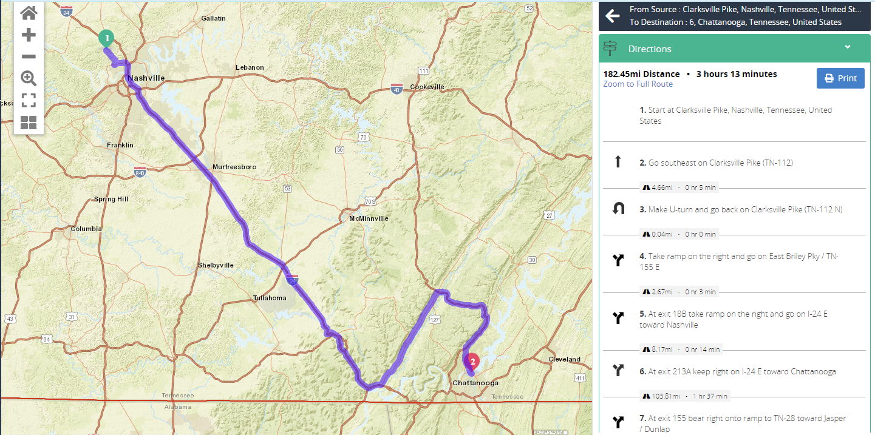
CTS-PARS
Route with turn-by-turn directions

Slide 9
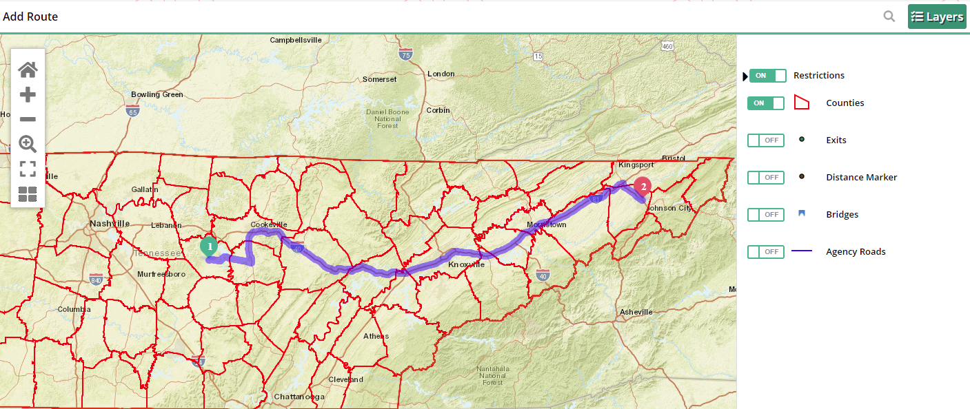
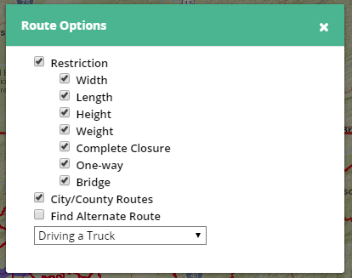
CTS-PARS
Configurable Layers and Routing options

Slide 10
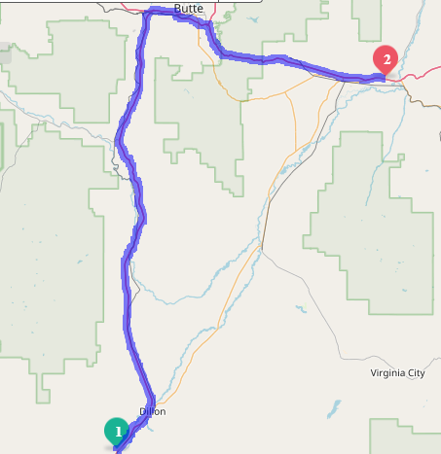
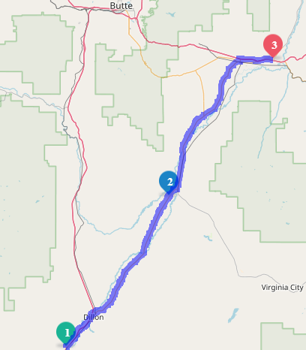
CTS-PARS
Select Desired Route
Origination/Destination
Review System Generated Route
Change Route
Drag and Drop
Add Stops
Notes:
Application# 337
Route From MM 56 I-15 N to MM 253 I-90 E

Slide 11
CTS-PARS
Route Envelops
Envelope – Pre-Approved Routes: Available to all – Safe for Travel
Trip – Saved Routes: Carrier Specific
Reuse – Save Time
Notes:
Application# 394
Envelope: Plaza Mall to Copper Company Butte
Trip: Anaconda to Butte

Slide 12
CTS-PARS
Restriction Management
Multiple Restriction Type
Ability to Manage Restrictions
Automated and Manual Notifications
511 Restrictions

Slide 13
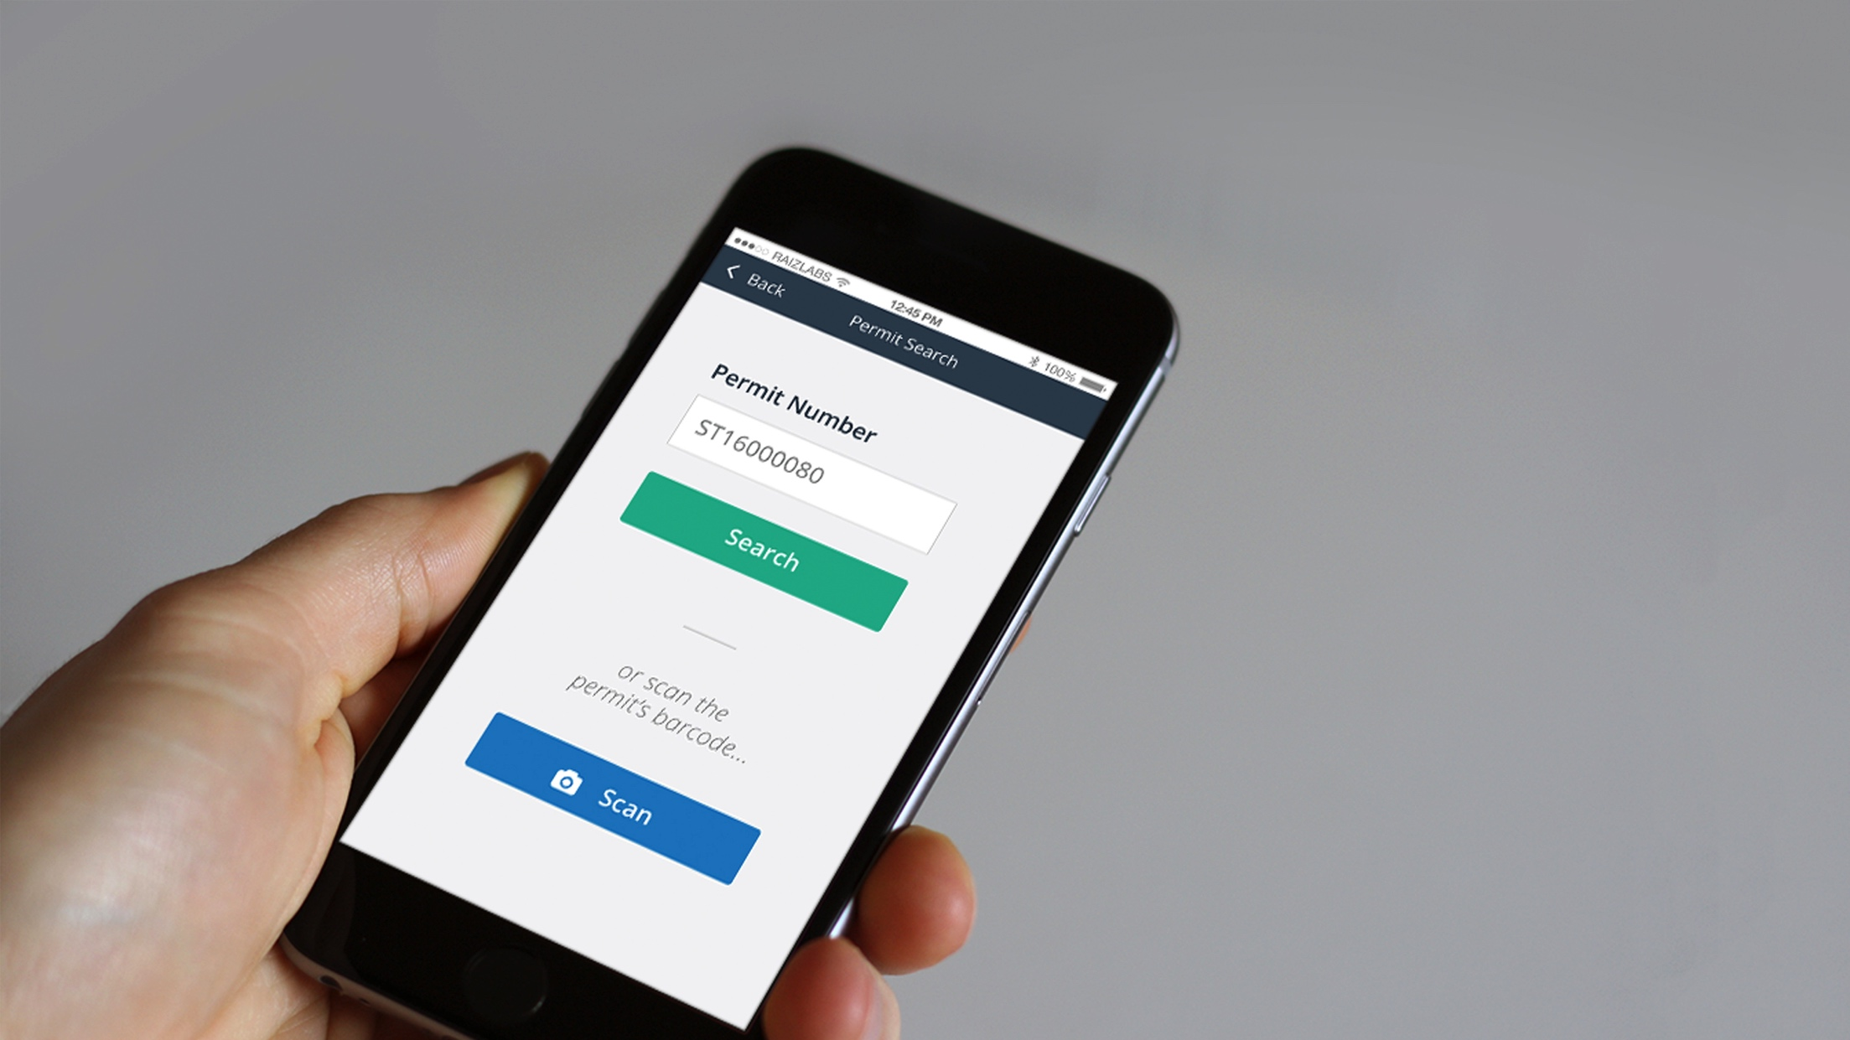
CTS-PARS
Mobile Functionality
Carriers / Third Party
View Permit Route on mobile device / PDF
Law enforcement
Scan / View Permit Route
Agency User
Workflow Approval

Slide 14
CTS-PARS

Slide 15
THANK YOU!
CTS-PARS
Dan Kiely
Senior Business Analyst
dkiely@celtic.bz
406-227-5284
www.celtic.bz

