Slide 1

WASHTO 2021
Oklahoma City
Tom Robinson
GE Renewable Energy

Slide 2
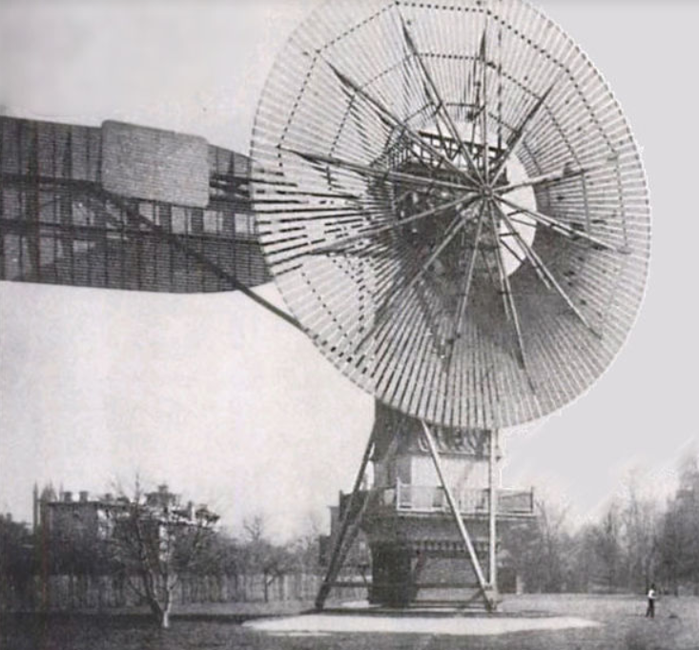
Year 1888
Charles Brush
Cleveland Ohio
The first Wind Turbine in the USA

Slide 3
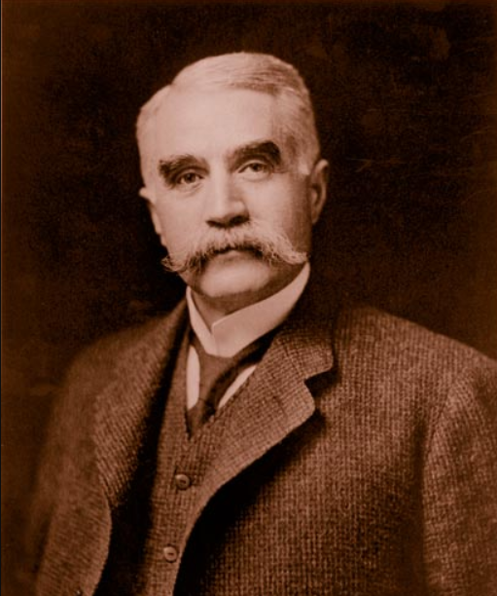
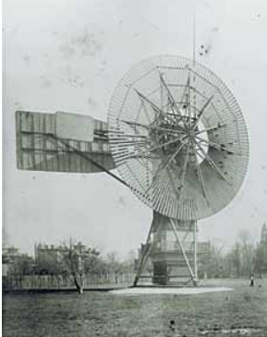
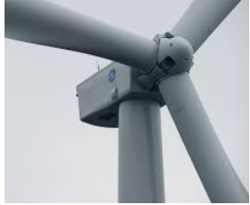
Charles Brush – One of the founders of the American Electrical Industry
First Wind Turbine 1888
50 feet tall
144 rotor blades
12 kW
1000 kW = 1 MW
GE 2X Turbine 2012
300 + feet tall
3 rotor blades
2.8 MW
1892 Brush Electric was sold and was merged with Edison Electric company under the name?

Slide 4
What is happening in Wind Energy?
Components are getting larger – Greater MW Turbines 5X
More remote project locations – Harder to reach by Truck
Industry trends look favorable – Recent Legislation

Slide 5
How many Megawatts in 1 Gigawatt?
10
100
1,000
10,000
Answer: 1,000MW = 1GW

Slide 6
North American Volume Projections
~5,000
Turbines

Slide 7
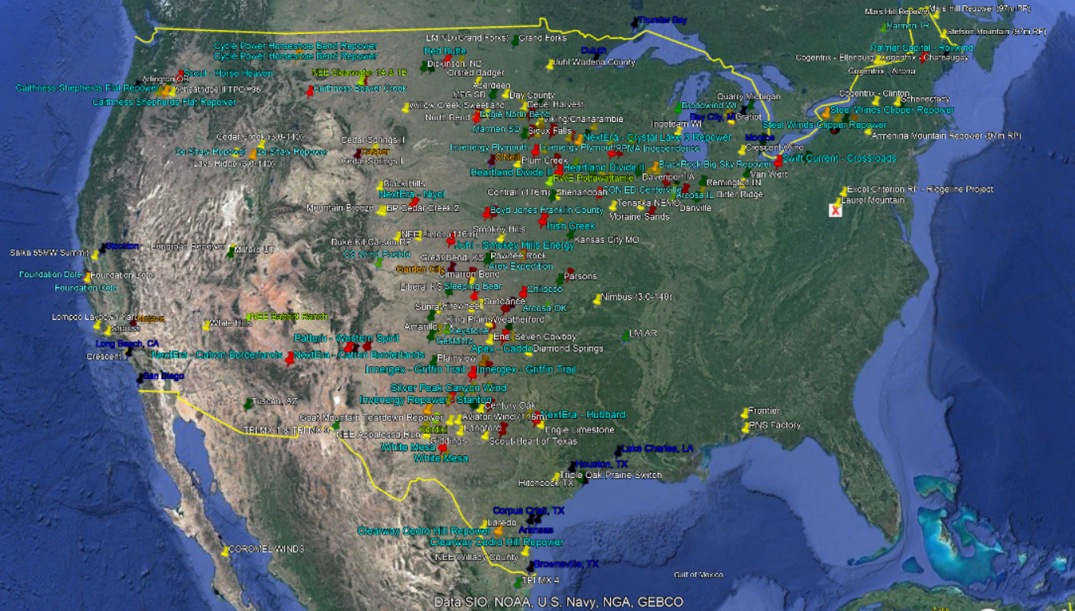
Where is the Wind?

Slide 8
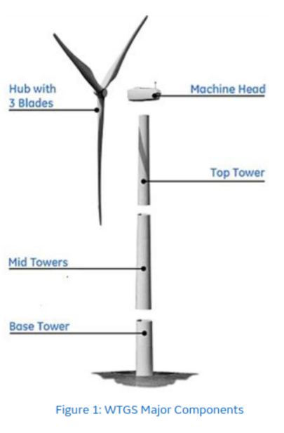
Components
Bigger and More Difficult to Transport

Slide 9
Blade and Tower Evolution
Blades
Towers
- 2012 37 – 49 Meter Blades = ~180 feet
2013 - 2015 - 50 - 57 Meter Blades = ~205 feet
2016 – 2018 62 - 67 Meter Blade = ~240 feet
2019 – 2021 Two Piece blade = ~ 260 feet
2023 80 Meter single piece blade? = ~324 Feet
- 2012 3 Section Tower
2013 - 2015 3 Section Tower
2016 – 2018 3 – 4 Section Tower
2019 – 2021 5 Section Tower
2023 5+ Section Tower – Probably not

Slide 10
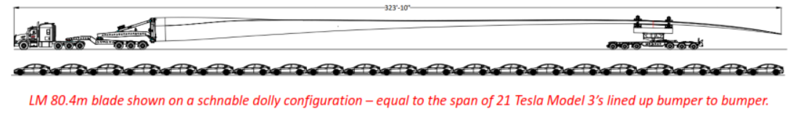
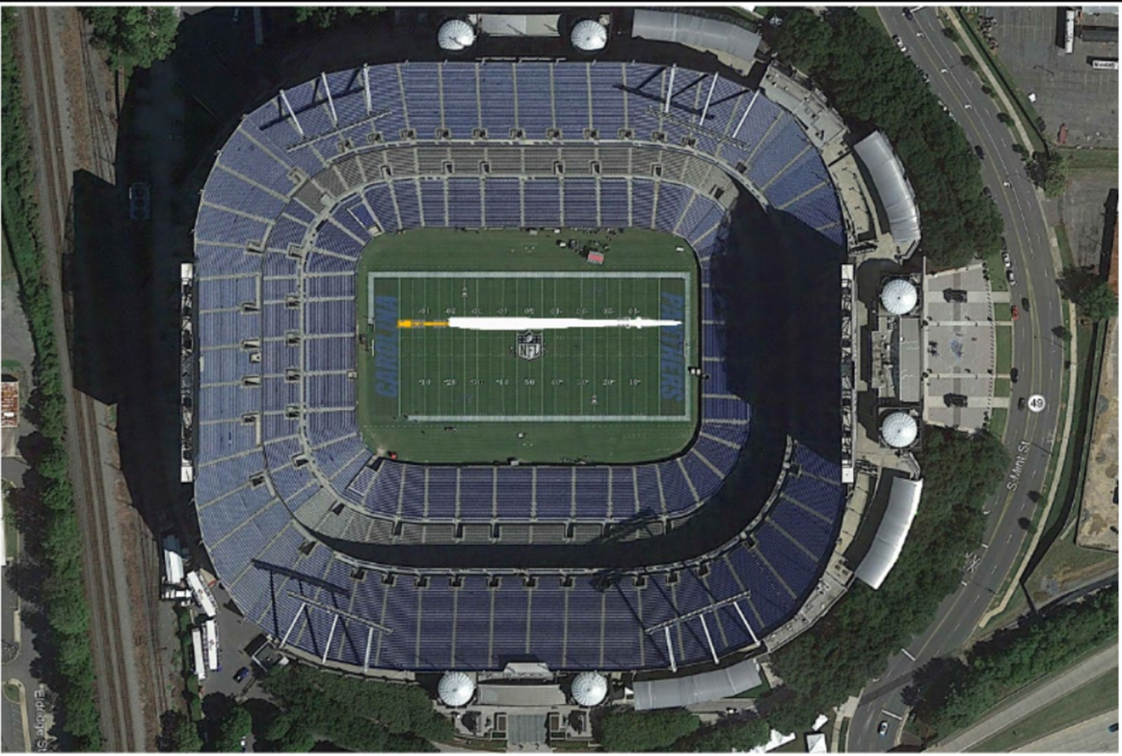
80m Blade

Slide 11
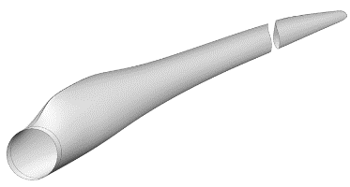
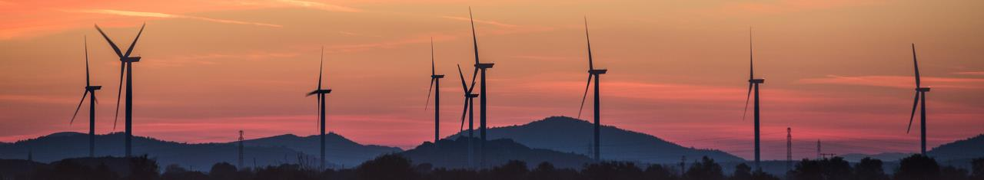

Two Piece Blade Technology - Summary
10Y+ of research, design & manufacturing experience
Significant logistics savings
Simple assembly on site
Root Section
(~60m)
Tip Section
Joint Technology
Access Hatch
Chord Pin
Radial Pin
Spar beam – constructed into the tip section at time of tip manufacturing
Receiver – constructed into the root section at time of root section manufacturing
11
11
Notes:
NO WT20 on Avangrid/RES … yes on Scout

Slide 12
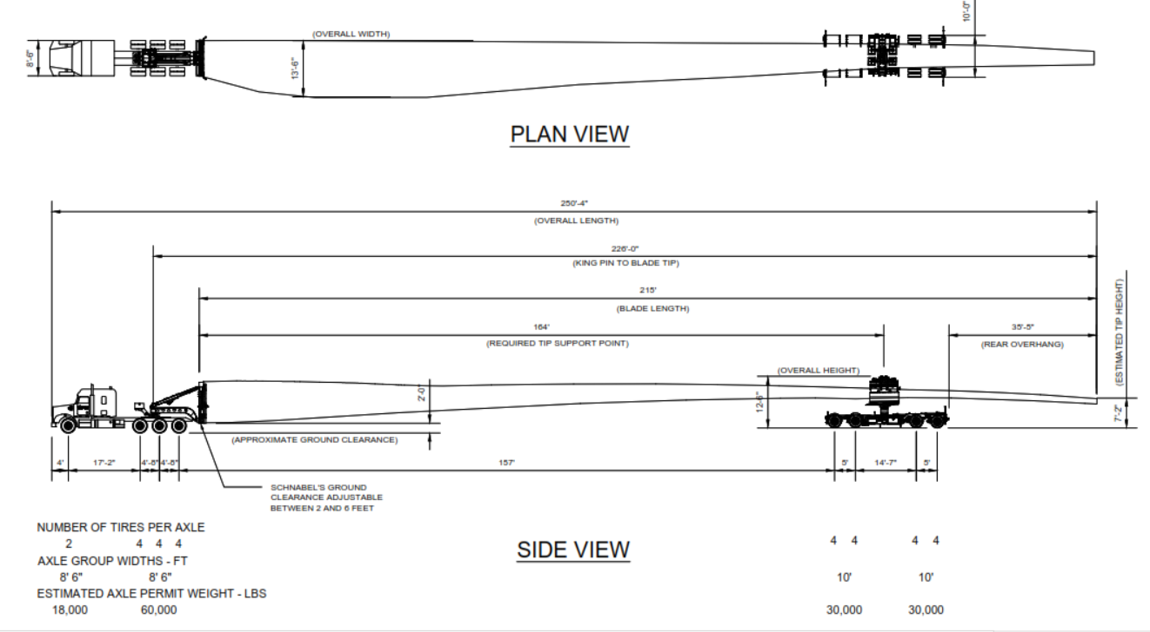
Schnabel Dolly

Slide 13
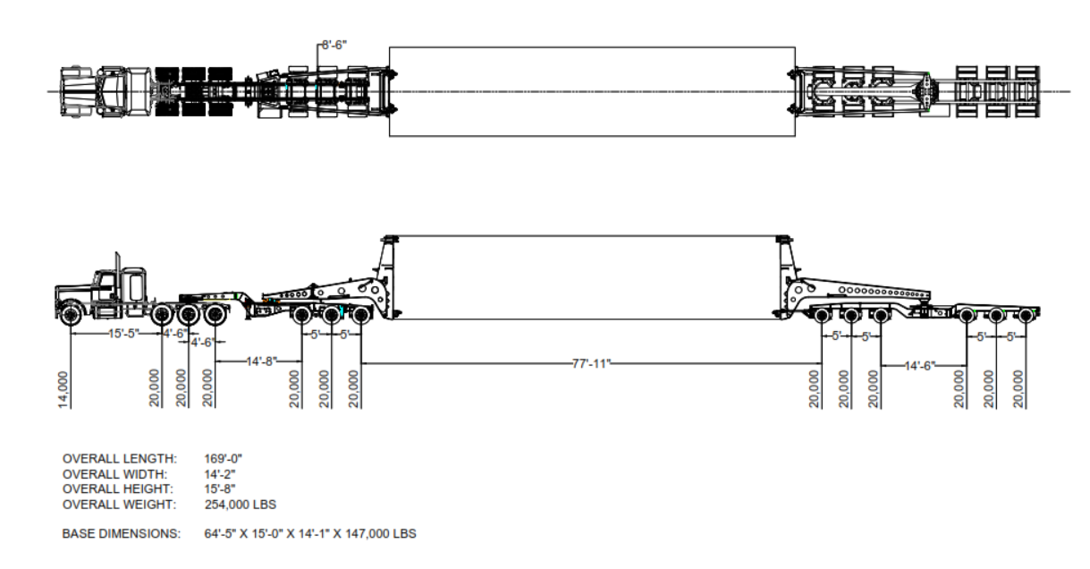
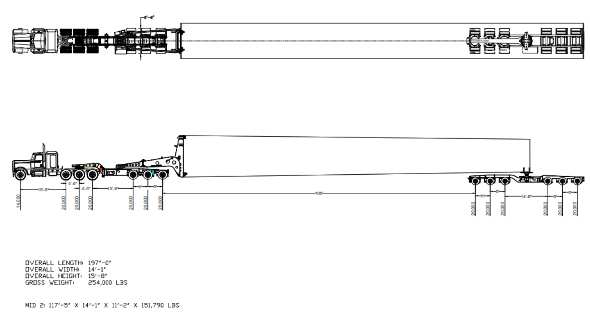
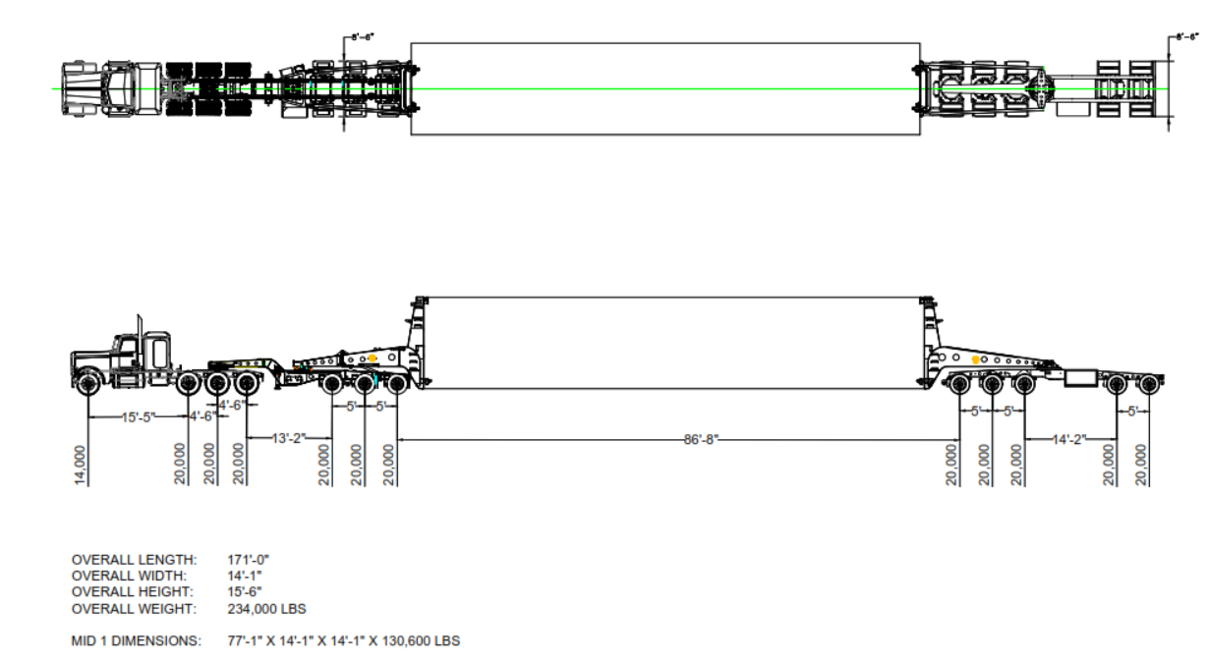
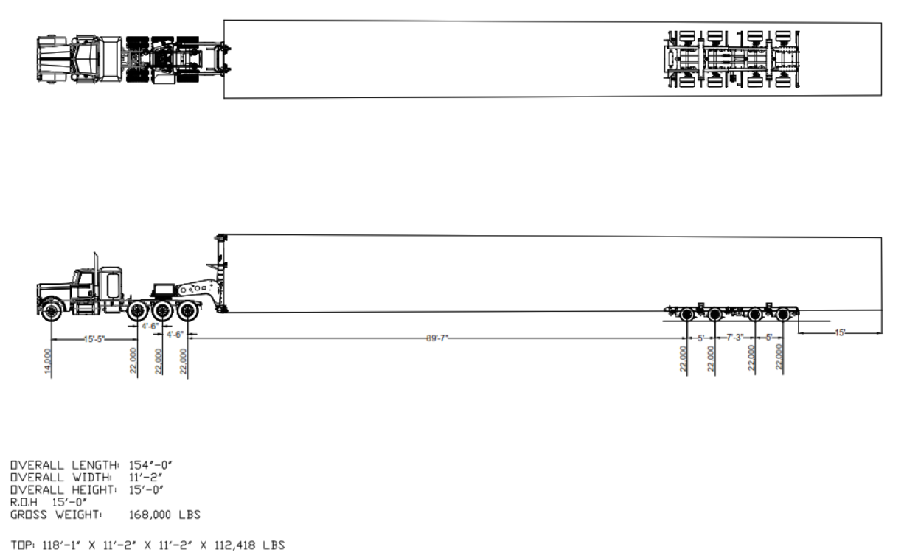
Tower DIMs – 4 Section Tower

Slide 14
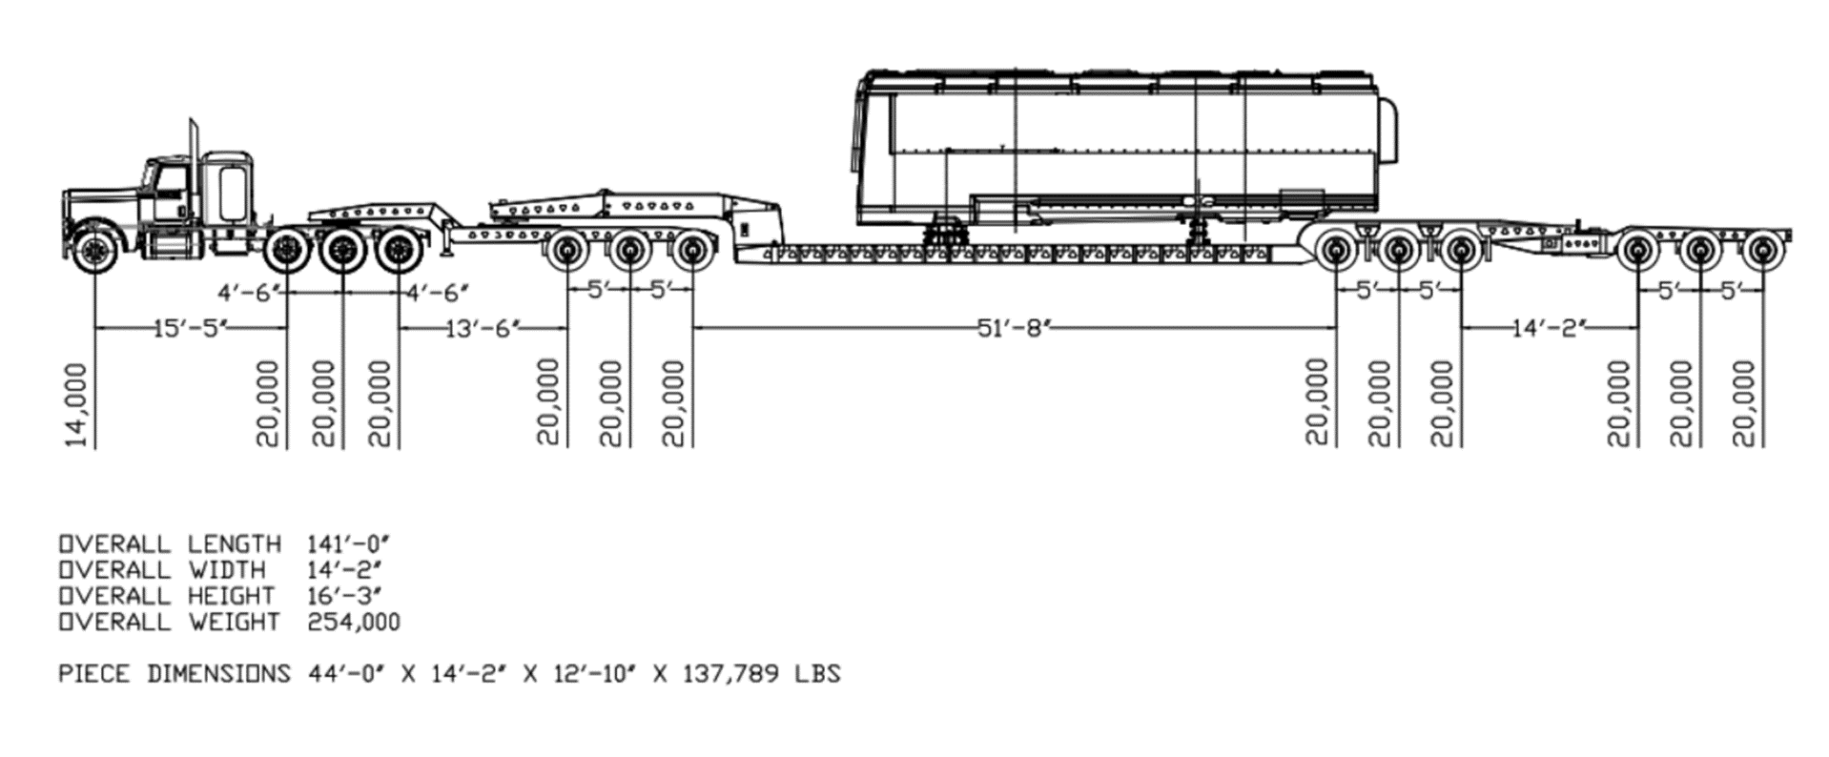
Nacelle

Slide 15
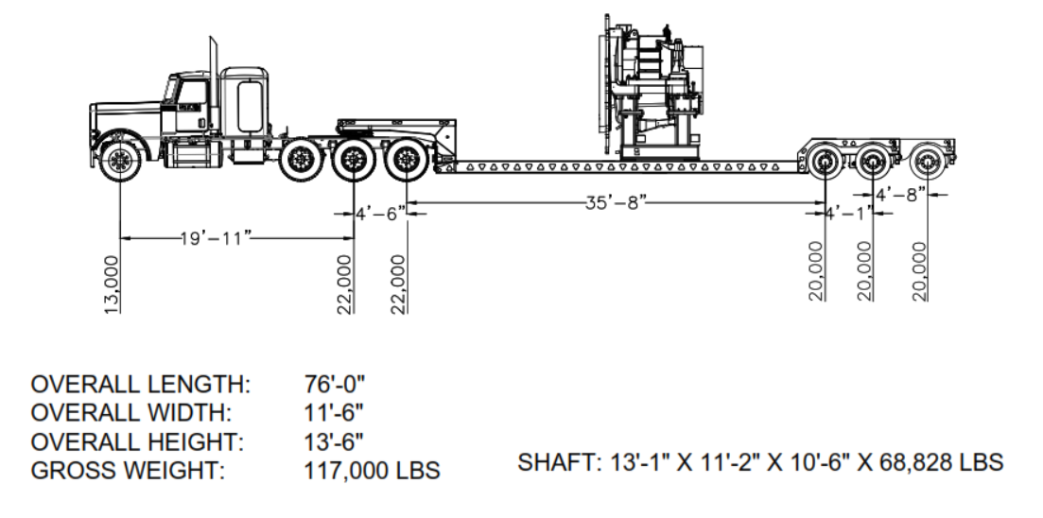
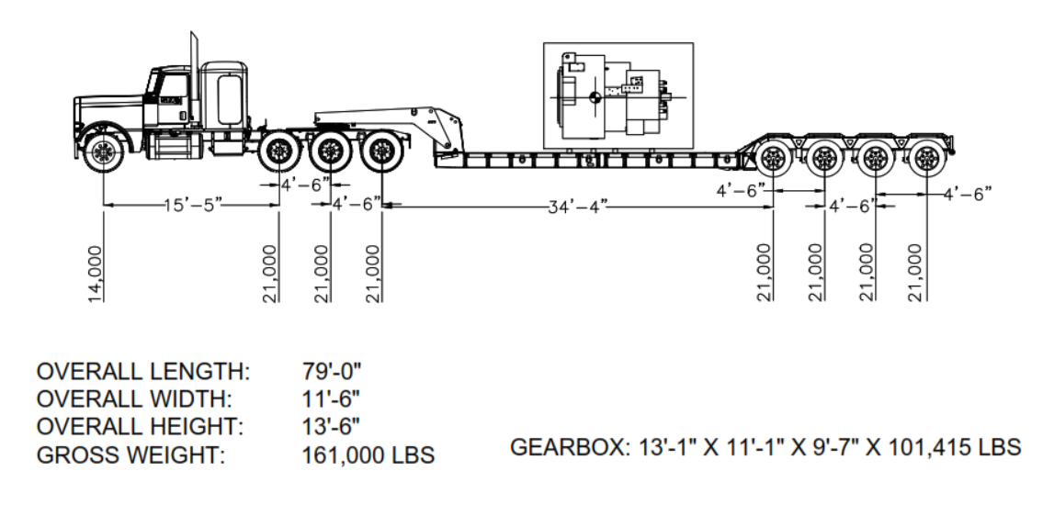
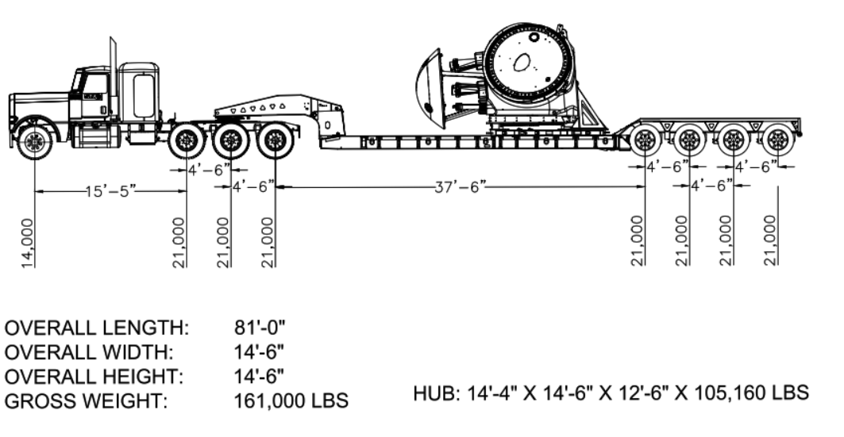
Other Permitted Loads
1.
2.
3.
Drivetrain
Gearbox
Hub

Slide 16
Challenges
1. Routing and Permitting
2. Police Escorts
3. Site Readiness

Slide 17
Quality

Slide 18
GE Service Provider Quality Engineer (SQE) Role
LSPs = Logistics Service Providers; contracted companies that do trucking, rail, ocean transport, crane operations, etc.
Write Lifting, Handling, & Transport Specifications which set GE Standards
Coach LSPs on Lifting, Handling, & Securement of GE OS/OW Loads
On-board, Qualify, & Audit LSPs
Collect NCs (non-conformances) on LSPs
Track & Trend (analyze) NCs
Prepare Scorecards & Review w/LSPs with Continuous Improvement as the Goal
Incident Investigation & Root Cause Analysis
Preventive Actions & Lessons Learned
Improve EHS Culture & Conditions (in the transportation chain, from supplier to customer; example: site roads)

Slide 19
Examples of NCs
Blade - 56.9m | NC Description
Incident: w/Other Vehicle | Loading in Aberdeen, escort rolled into tip of blade.
Incident: Hit Pole/Sign/Stationary Object | Sun got in driver's eyes causing the blade to graze the top of a sign.
Incident: Hit Pole/Sign/Stationary Object | Making a turn and hit a branch.
Machine Head | NC Description
Equipment Failure | Leaving PNS plant and taking a turn onto the highway, his 5th wheel pin broke, trailer separating from the tractor.
Incident: Hit Pole/Sign/Stationary Object | Truck was trying to make a turn onto Hwy 359 from Hwy 83 when machine head made contact with the barriers.

Slide 20
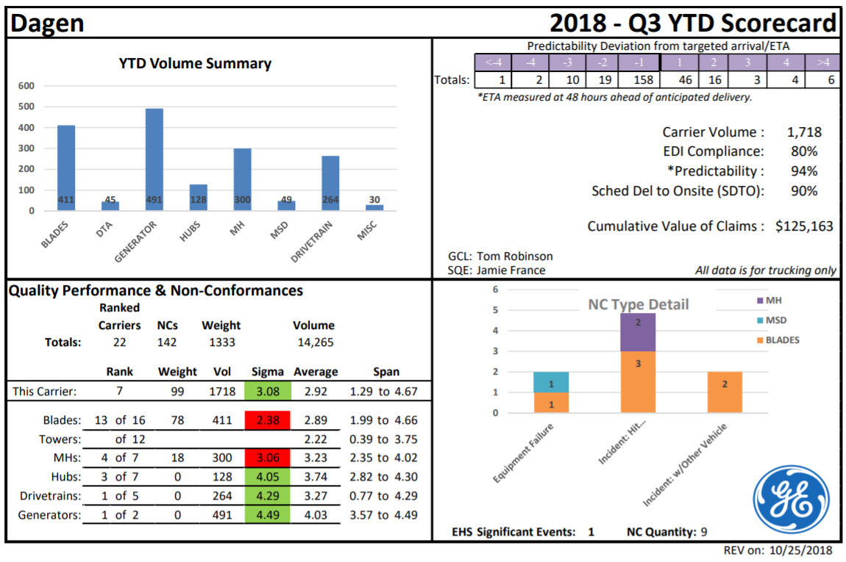
Example of a Scorecard
No NCs for early or late

Slide 21
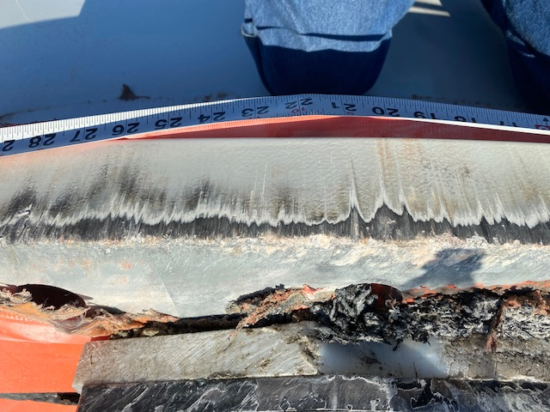
Example of Incident Investigation & Root Cause Analysis
Flash Report: GE REN-ONW Outbound Logistics | EHS Event Classification: Significant Event (Level C)
LSP: (Carrier Name) | Location: I-10 Near Eloy Arizona | Date/Time: August 31, 2020 @1700
Type of Incident (NC): Bridge Hit | Commodity: Tower Base | NC #: 210425857
Injury: None | Damage/Cost: TBD | Prepared by: John Im
Description of Incident:
Driver left the railyard in Tucson, and he was on his normal route.
This was his fifth trip to White Hills on this route.
All base tower drivers on this route have to raise their tower to get over the RR tracks and for the turn onto Cobb Road.
The driver raised his tower, made it thru the turn, and replaced the sign that had to be removed. At this point, the driver should have lowered the tower back to the permitted running height, but he did not do so.
On Interstate 10, the tower hit the bridge at mile marker near 220, causing damage to the tower flange. No injuries.
Containment:
Driver pulled off safely on an exit ramp.
Site has refused section and planning on sending back to Tucson for repairs and to send a replacement Base.
Carrier has informed police of bridge hit.
Root Cause:
Lack of layers of defenses to mitigate risks of human error.
Corrective/Preventive Actions | Responsible | Closure Status/Date
GE requirement for visual indicators anytime a tower height is adjusted from permitted height. | John Im | Oct 2020
GE Quality EHS team to evaluate bridge hit SODM to determine potential additional defenses. | John Im | Sept 2020
Pursue pilot test of technology solutions (such as Lidar) | John Im | 1st QTR 2021

Slide 22
Example of Incident Investigation & Root Cause Analysis
REN-ONW Outbound Logistics 5 WHY
Tower base section hit a bridge
How is it possible that the driver can forget to lower back down? There are no visual indicators or technology in place, to ensure the tower is at its permitted load height.
Why was the Base higher than bridge? Driver had to raise section to clear RR tracks and forgot to lower back down.
RC1: Lack of layers of defenses to mitigate risks of human error. (visual indicators, technology solutions - Lidar, call in to dispatch)
Why did Base section hit a bridge? The tower base was higher than the height of bridge.

Slide 23
Other Risk Reduction Measures
Three Private Escorts per Blade & Tower
WITPAC - Wind Industry Transportation Professional Advanced Certification
    Welcome to WITPAC (2) – YouTube
Lockout / Tagout – LOTTO
Route Survey Support
Site Monitors
Site Safety Auditors

Slide 24
Questions

