Slide 1

Why WITPAC?
Wind Industry Transportation Professional Advanced Certification

Slide 2
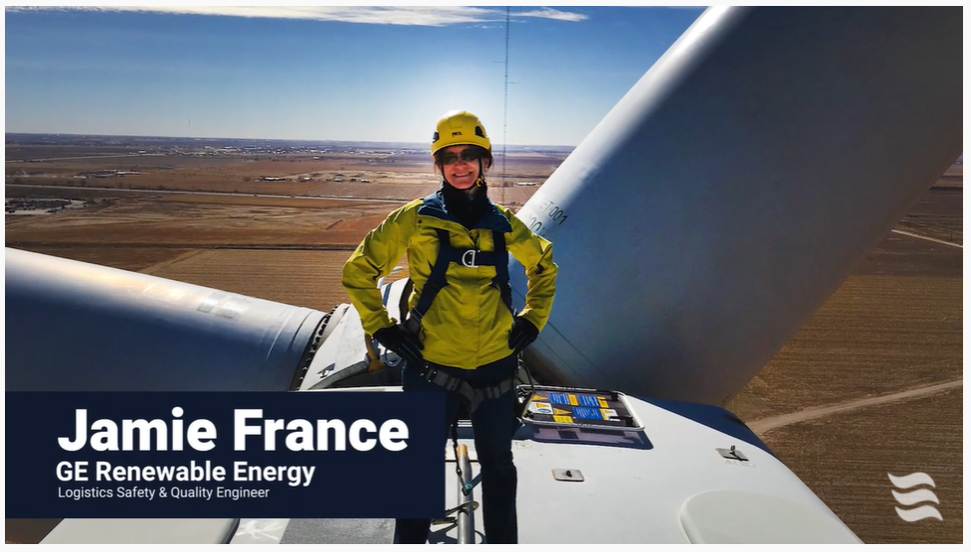
Click for video: https://youtu.be/ODijUoyVtmE

Slide 3
For More Information Visit:
https://www.esc.org/witpac

Slide 4
Jeffrey Vaughan
President/Executive Director
jeff@esc.org
425-238-6559

