Slide 1
Work Zone Safety Reset
WASHTO
Chris Christopher, Director of Construction
Mar 28th, 2023
Roger Millar, Secretary of Transportation
Amy Scarton, Deputy Secretary of Transportation

Slide 2
Work zones are getting more dangerous
Tacoma contractors severely injured in crash in I-5 construction zone (q13fox.com)
Notes:
DONGHO

Slide 3
Work zones are getting more dangerous
Fatal crash blocks southbound I-5 near Arlington | king5.com
Notes:
DONGHO

Slide 4
Work zones are getting more dangerous
On October 7th just after midnight on SB I-5 near 56th Street in Tacoma our maintenance crews were sweeping the shoulders.
A driver hit our truck mounted attenuator (TMA) that was in place protecting our workers.
Soon after, a TMA moved into place protecting the collision scene was also hit.
A third vehicle then tried to cut through the scene to take the 56th street ramp and hit one of the cars involved in the first crash.
The WSDOT Blog - Washington State Department of Transportation: Increase in work zone crashes leads to safety adjustments to protect workers, drivers
Notes:
DONGHO
State and national problem of more risky driver behavior

Slide 5
WA work zone crashes by the numbers
2021 work zone collisions resulted in:
5 fatalities
28 serious injuries
283 minor injuries
916 incidents of property damage
In 2022 (through mid-August) there have been:
4 fatalities
6 serious injury collisions
Washington 10-year work average
626 work zone injuries a year
*Deaths and fatalities stats include roadway workers and travelers
Notes:
DONGHO
What we hear from workers: slow down and put phone down
Our crews say they regularly see drivers looking at phones or other devices and blowing past signs about slowing down or stopping – which puts everyone on the road at risk.

Slide 6
Moving in the wrong direction WA state fatal and serious injury crash stats
Notes:
DONGHO
This is ALL fatal and serious injures on state roadways – not just work zones

Slide 7
The challenge
Recent changes in driver behavior and increasing crash trends are at odds with Worker Safety goals
We MUST adjust our strategy to protect everyone working in the field
Applies to all field work; Construction, Maintenance, Field Exploration
Lots of newer people in key positions; huge delivery demands
Many of our stakeholders are demanding that we respond and adapt quickly
Notes:
DONGHO
Our staff and our partners in law enforcement report seeing more risky driving – both in numbers and severity of the risks (100+ mph)
The National Highway Traffic Safety Administration reports Washington state had 557 highway traffic fatalities in 2020, a 3 percent increase from 2019 even with drastically reduced traffic due to the pandemic.
According to the state Traffic Safety Commission’s 2020 Distracted Driving Observation Survey, the statewide distracted driver rate increased from 6.8 percent in 2019 to 9.4 percent in 2020. The increases included all types of driver distraction, not just hand-held cell phone use.

Slide 8
The impact triangle
Notes:
CHRIS

Slide 9
July 11, 2022 Safety Reset
Notes:
CHRIS

Slide 10
Actions we have taken
Notes:
Provide motorist real time information about work zone related congestion.

Slide 11
What does a Safety Reset look like?
To keep both the workers and all of the traveling public safe, we’re taking some extra steps and using some tools more often, where appropriate.
This means leaning a bit more toward safety in the impact triangle.
Not a one-size-fits-all situation, but all projects should keep options in mind.
This will mean more slow downs and congestion at times – but we simply must keep workers and travelers safe in our new roadway reality
Examples :
Scheduling more daytime projects
Reducing the number of times crews are exposed to traffic
Supporting automated speed enforcement laws for work zones
Closing more lanes/creating a longer work zone area to create a larger buffer for crews
Re-examining existing tools as well as new strategies and proven techniques to improve work zone safety
Reviewing and evaluating contractor safety suggestions on every project
Notes:
CHRIS

Slide 12
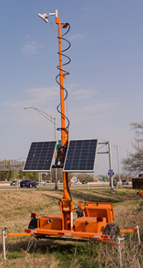
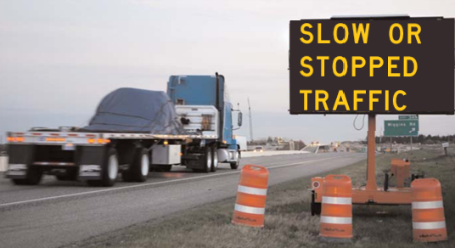
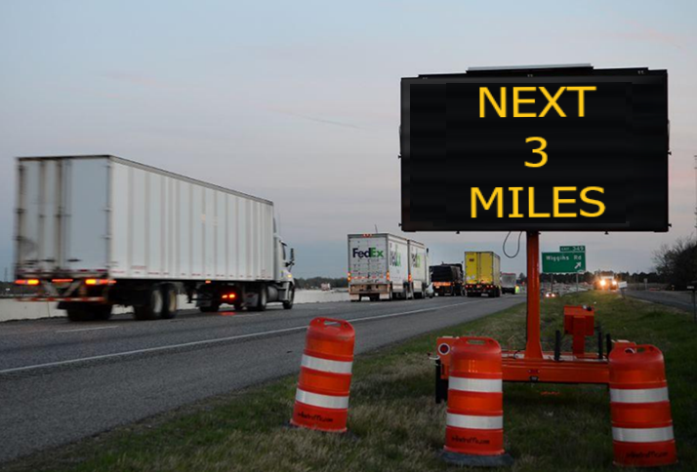
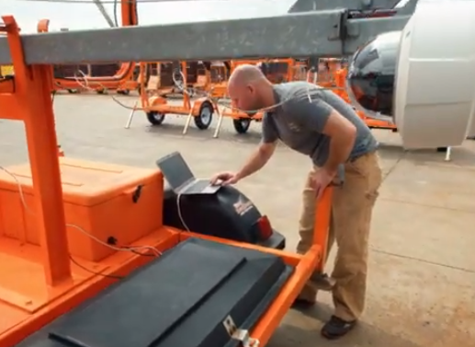
1. Real-time information to motorists
Notes:
CHRIS
Provide motorist real time information about work zone related congestion.

Slide 13
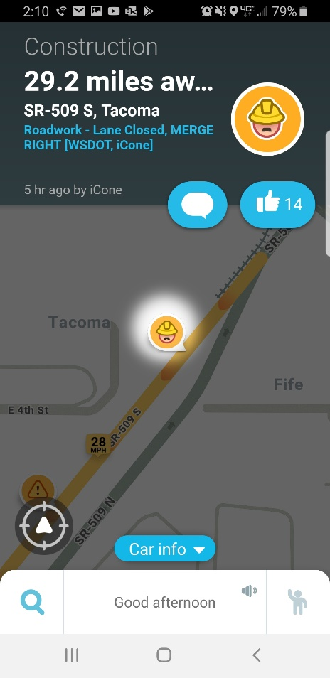
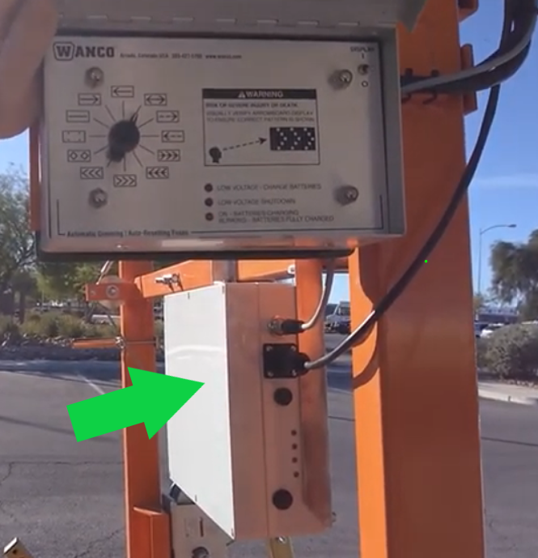
2. Utilizing smart work zone technology
Smart Arrow Boards now required on all interstate projects
Notes:
DONGHO
Begin using work zone devices the provide work zone activity data.
Left photo, existing WSDOT arrow board retrofitted with communications device. (iCone product in this case)
Right photo is a screen shot of a Waze post from the arrow board in action on SR 509 in Tacoma. Notice the post is from “WSDOT, iCone”

Slide 14
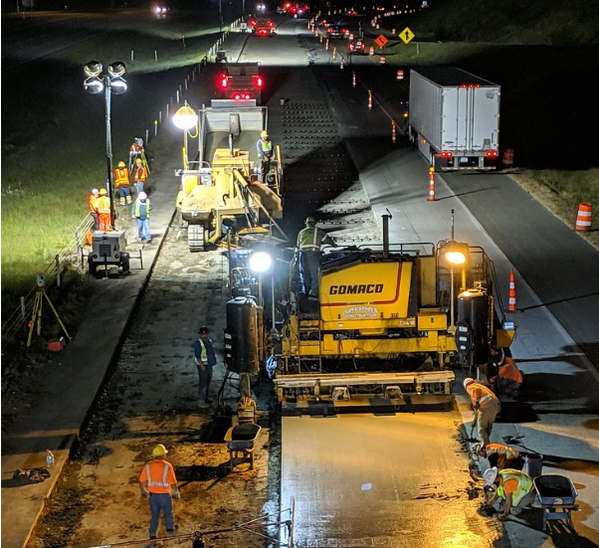
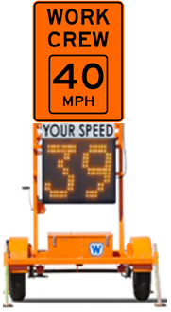
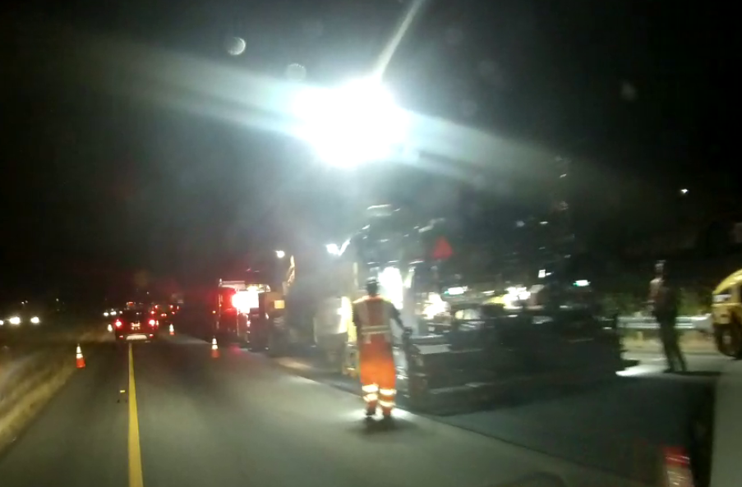
3. Speed limit reductions in work zones
Notes:
CHRIS
Continue to use speed limit reductions during active work zones when workers are present.

Slide 15
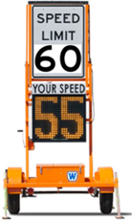
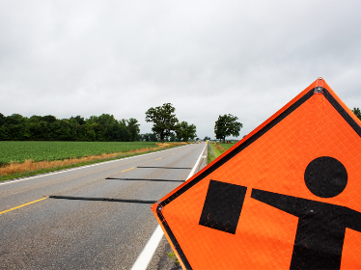
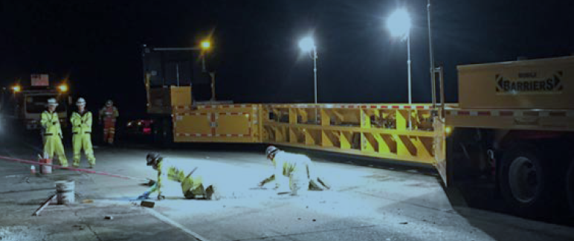
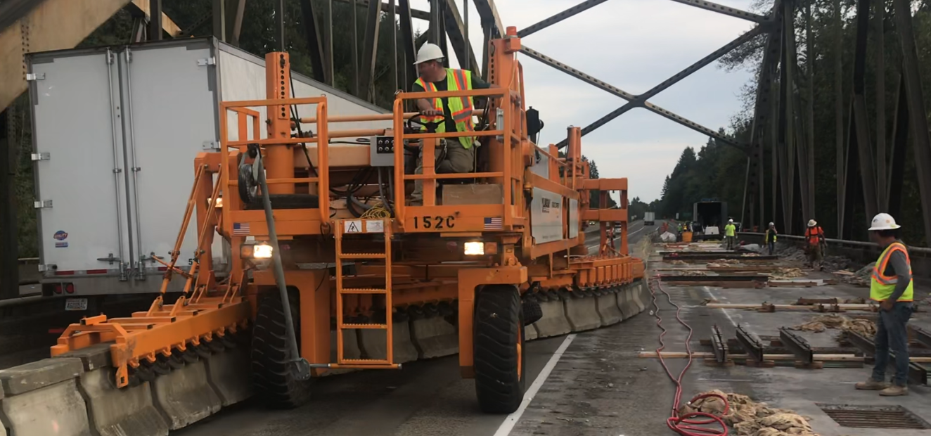
4. Work zone safety contingency
New force account bid item added to efficiently implement enhancements to work zones without going through the change order process
Weekly meeting between Contractor and Engineer to discuss traffic management
If mutually agreed, implementation of enhancement paid as force account
Work Zone Safety Contingency enhancements include
Additional Signing
Radar Speed Display Signs
Additional PCMS or Arrow Boards
Temporary Rumble Strips
Use of Automated Flagging Devices
Mobile barriers or additional Truck Mounted Attenuators (TMAs)
Notes:
CHRIS
Work Zone Safety Contingency enhancements do not include and will require a change order
Changes to work hours - Different staging approach
UPO or WSP (these need agreements)

Slide 16
5. Design-build contracts and work zone strategies
Creating safe work zones will now be added to the contract scoring criteria for design-build contracts.
This includes:
Strategies to reduce worker exposure with equipment/devices
Manage overall worker exposure with closure/detour strategies
Incorporate smart work zone devices and applications to better manage traffic through work zone
Ensures that work zone safety is included in the project from the very beginning
Reinforces the critical nature and priority of work zone safety
Notes:
CHRIS

Slide 17
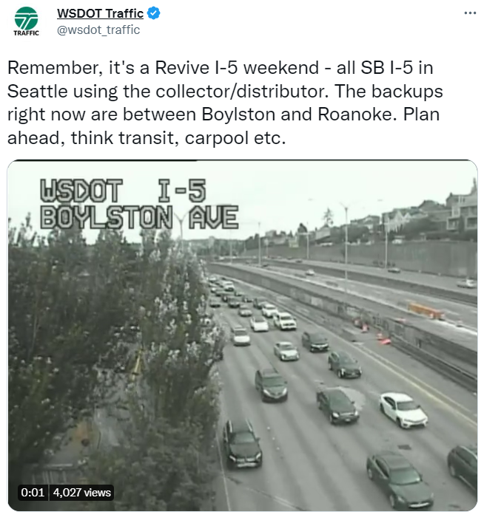
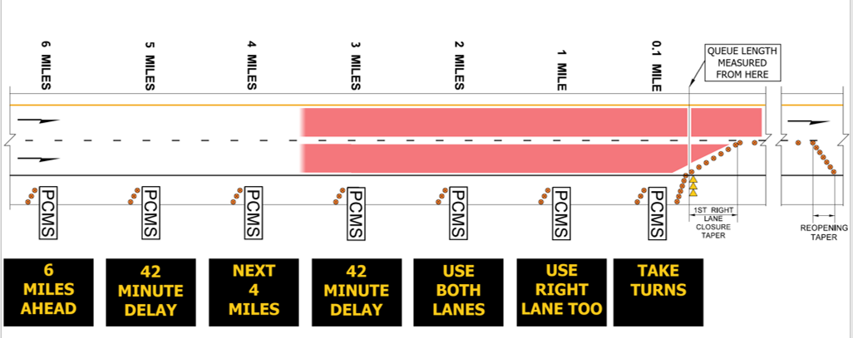
6. Updating our work zone training
Reflecting the “Reset” perspective:
Extending roadway closure times
Proactive public outreach
Smart work zone technology
Queue warning systems
Other items such as temporary rumble strips
Great existing training made even better!
Notes:
DONGHO

Slide 18
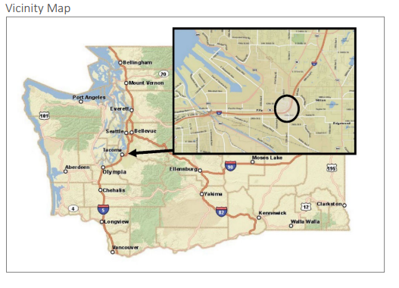
7. Orange contrast marking pilot
Experimental contrast orange markings will be included State Route 167 Completion Project
Experiment is like black contrast markings already in use
Primary objectives
Increase driver awareness
Reduce work zone incidents
Caltrans is current conducting a similar experiment
Notes:
DONGHO
Other states have experimented with orange work zone markings over the past several years. In most cases work zone markings were entirely replaced with orange in various ways. Research has generally been mixed except in all cases driver response that has been positive.
WSDOT’s plan is to provide orange contrast markings along with existing work zone lane lines.
The reason for this choice is for a few reasons
First to maintain driver expectation by keeping markings that we are used to seeing
Second is to enhance visibility of lane markings that are sometimes difficult in work zones
Contrast markings like black markings on concrete pavement have been used successful around the country for a long time; and
This approach is considered a practical and cost-effective strategy
The objectives of the experiment include
Increasing work zone awareness
Reducing work zone incidents or intrusions
Maintaining work zone speed and reducing speed variability
Improving lane discipline and driver behavior
Only CalTrans and WSDOT are examining orange markings as contrasting versus replacing all markings

Slide 19
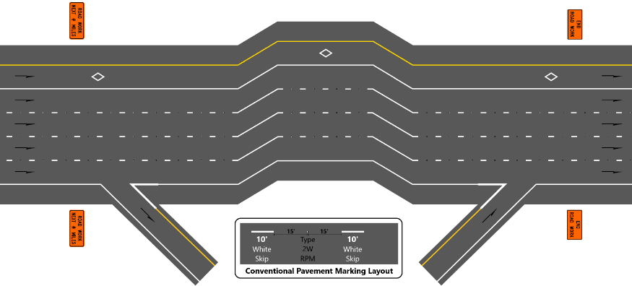
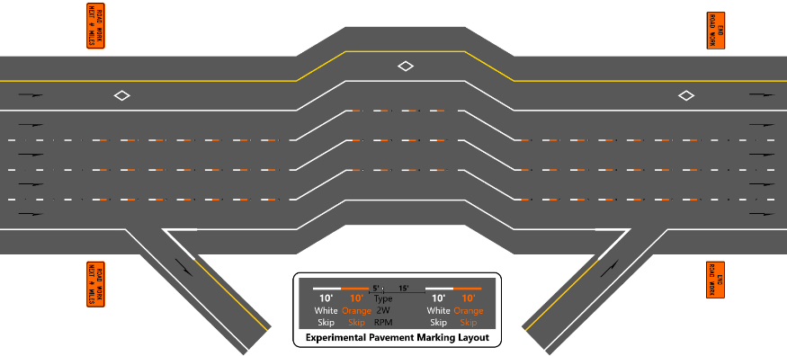
7. Orange contrast marking pilot
Before Condition (typical)
What will be measured?
Marking Visibility
Traffic Volumes
Traffic Speeds
Reported Crashes
Driver Behavior
Work Zone Intrusions
Public Perceptions
After (Orange) Condition (typical)
Notes:
Departures from the Manual of Uninform Traffic Control Devices requires approval from FHWA in the form of an experimentation request. This includes monitoring and reporting
The department plans to monitor the work zone lane and geometric conditions in a before condition with no orange contrast. Then monitor the work zone with the only change being the added is the orange contrast markings.
Most of the data collection is straight forward but the department desires to augment speed and incident information with driver behavior. This will be qualitative effort as staff will view and catalog targeted video of the work zone to examine for driver lane behavior.
Finally, the project office is preparing a communication plan to (1) alert drivers to the change in markings but (2) to encourage drivers to participate in a survey. Success is not just defined by numbers but user experience too.

Slide 20
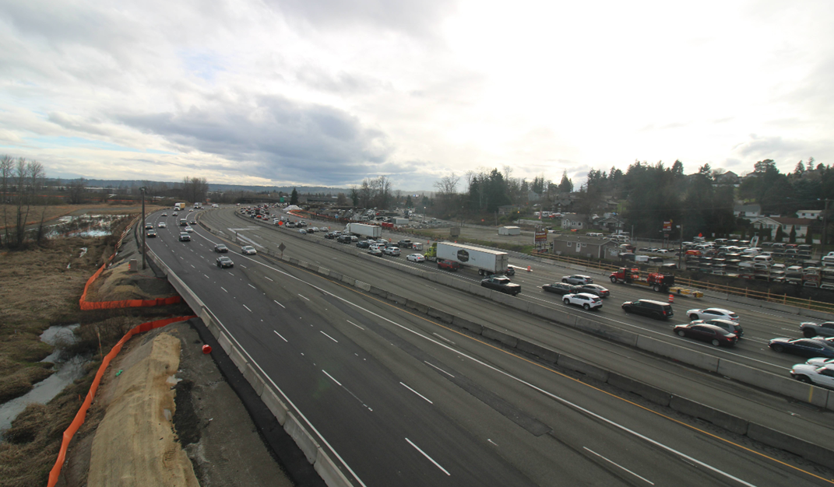
Interstate 5 – southward view of work zone
Notes:
The photo to the right is looking south into the work zone. The NB direction or the on-coming vehicle lanes shows the lane configuration that will be tested. The southbound lanes at the time of this photo had not been transitioned yet.
Our hope is this experimentation will not only enhance the experimentation site in Washington State but also contribute FHWA knowledge on orange work zone markings
Let me know if you have any specification questions and if there is something I cannot answer I can connect you with our project team.
Thank you

Slide 21
8. USI group formed
Unions, State Legislators, Industry
Goal – Partner with WSDOT, Unions, State Legislators & Industry to enhance work zone safety:
Work zone design
Legislative actions
Public awareness & training
Sen. Liias and Sen. King actively involved
Notes:
CHRIS

Slide 22
Work Zone Risk Reduction Committee
Members:
Washington Asphalt Paving Assoc. (WAPA)
WSP
Unions
Paving contractors
AGC
WSDOT
Meets quarterly
Detailed work zone issues worked through in a collaborative manner - i.e. specification changes, procedural changes etc.
New ideas/concepts discussed, along with implementation
Notes:
CHRIS

Slide 23
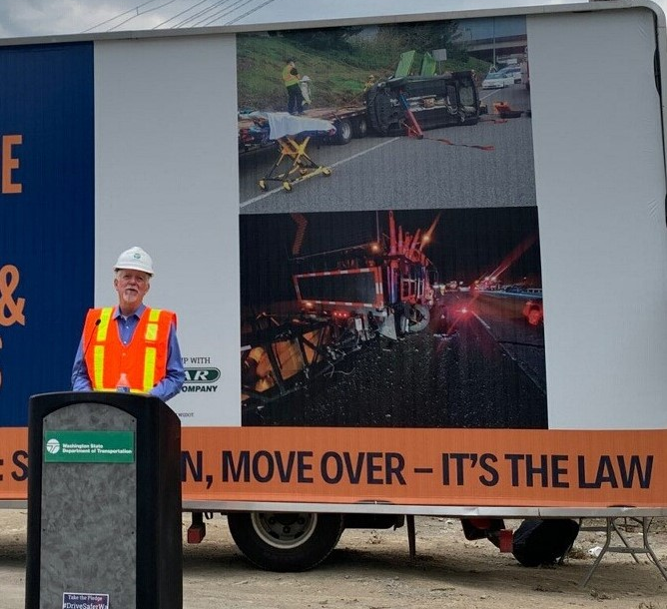
9. Continued significant public outreach
Both internal with WSDOT and external w/ USI, etc.
Safety is key to all WSDOT outreach using many tools and outlets
2022-2023 winter messaging
Stresses driver preparedness
Safety of workers and travelers key to all messaging
2023 Work Zone Safety Planning/Efforts
Continue to share messages with each incident for on-going impact
Stress safety in all outreach
Amplify others’ safety messages
Month-long Work Zone Safety emphasis in April
Notes:
CHRIS
Safety is the key to all of WSDOT’s messaging, whether it’s a weather post, road closure announcement, blogs or specific campaign messaging.
Every spring/summer construction season kicked off with a month-long Work Zone Safety Awareness efforts, including blogs, social media, outreach to tv and print media, the annual Worker Memorial ceremony (returning in 2023) and posts about every crew injury or near-miss.
Roger photo from Aug. USI press conference/kick-off

Slide 24
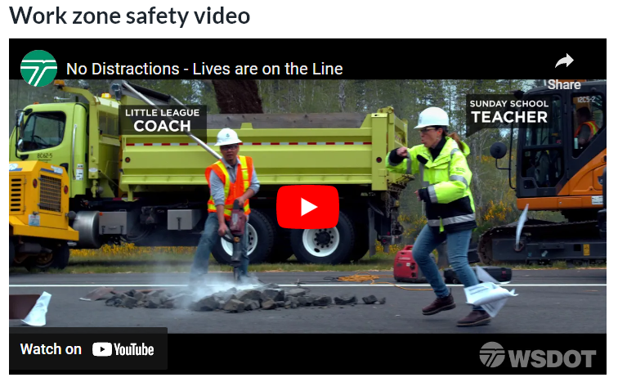
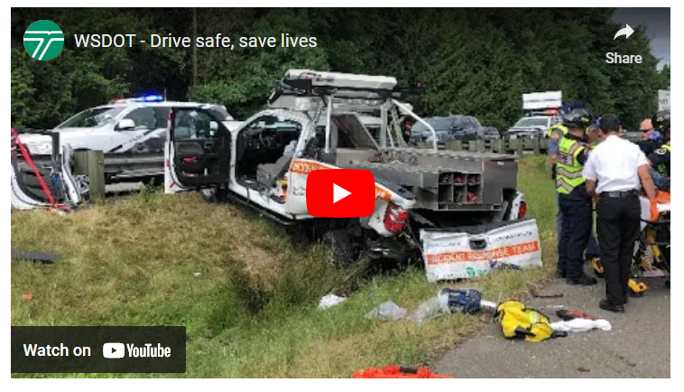
Ongoing public outreach and education
No Distractions – Lives are on the Line
Drive safe, safe lives
https://www.youtube.com/watch?v=amuCObfbJsM
https://www.youtube.com/watch?v=H8SXTngGpZY
Notes:
CHRIS
No Distractions video produced with WAPA
Drive safe, save lives video from 2021, after we’d witnessed the alarming driving behavior
Drive save video IRT crash:
In May 2021, one of our Incident Response Team drivers was seriously hurt on I-405 in Bothell when a driver struck his truck in a lane closed to traffic.
Police say the driver was impaired.
This same IRT worker has been hit three times since 2016 while responding to drivers needing help on the highway.
And our partners, including tow and contractors, also have had terrible crashes, injuries and even deaths.

Slide 25
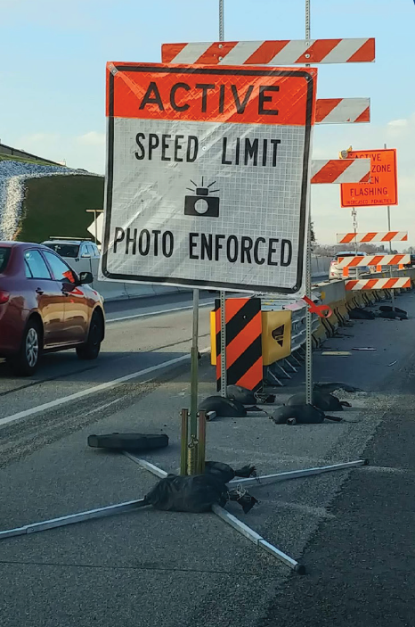
10. Automated enforcement Speed safety camera systems
What would this legislation accomplish?
The current Senate and House bill versions would generally authorize:
WSDOT to make rules to implement, administer and operate speed safety camera systems on state highway work zones.
Washington State Patrol (WSP) to make rules and manage law enforcement activities such as issuing infractions and adjudication processes with Washington’s Office of Administrative Hearings
The current bill versions also require rulemaking to be done with input from agency partners including, but not limited to:
Department of Licensing
Washington Traffic Safety Commission
Organizations dedicated to the protection of civil liberties to ensure equity and access to justice for all
Notes:
DONGHO
Rule making could take the form of both “emergency” and “final” to expedite getting started with implementation of the program based on Senator feedback from USI
Rulemaking by both WSDOT and WSP
Develop Washington Administrative Code (WAC) details – multiple stakeholder meetings:
Criteria for when and where to deploy SSCS in work zones such as location, volumes, average speeds, etc. performance metrics and reporting
Speeding thresholds – maintain WSP discretion when issuing infractions
Defined fine structures – current vision is 1st time warning, 2nd and thereafter, two-year reset
Adjudication processes with Office of Administrative Hearings
Enhancing the framework for ongoing equity considerations
Other: Request for Proposals, hiring a vendor, contract administration processes, hiring program management staff

Slide 26
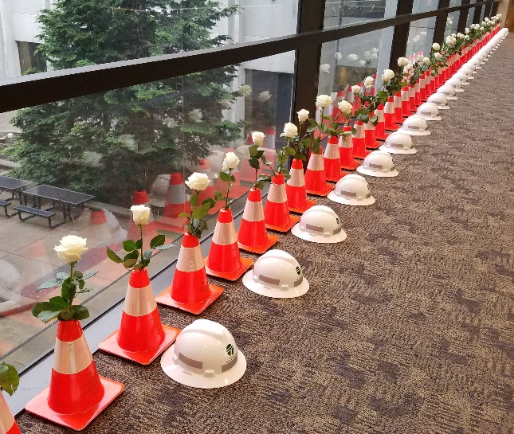
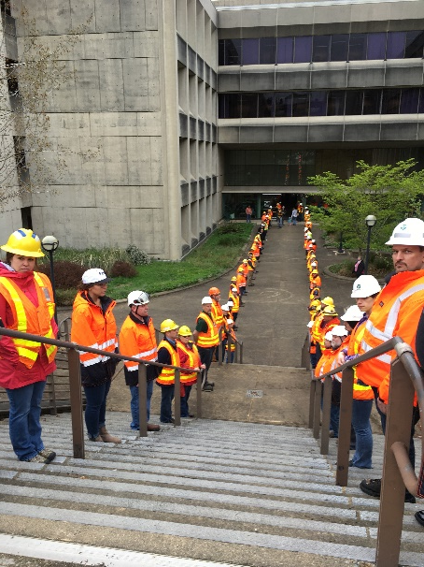
April: Work Zone Awareness month
2023 National Work Zone Awareness Week April 12-21
Kick off to spring/summer construction season
Public education
National event is a week, but we do a month’s work of outreach
Working with USI to leverage reach
WSDOT Worker Memorial returns – April 4th, 2023
Notes:
CHRIS
Look for invitations to this annual event (April date still TDB)
60 WSDOT workers killed on the job since 1950

Slide 27
Questions?
Chris Christopher
Director of Construction
christc@wsdot.wa.gov
360-705-7821

