Slide 1
Presentation to the WASHTO Committee on Highway Transport Denver, CO October 31, 2023 Dave Huft, SDDOT
AASHTO Committee on System Management and Operations (CTSO)
Subcommittee on Freight Operations
Notes:
Dave & Geno
Welcome everyone to today’s CTSO Subcommittee on Freight Operations Meeting. Our third meeting of 2023.
Speak to any additional opening remarks you would like cover.

Slide 2
Presentation Outline
AASHTO CTSO Annual Meeting
Traffic Operations Manual
Issues Related to Emergency Movements
FMCSA Final Rule on Declared Emergency Safety Regulation Waivers
Emergency Movement of Divisible Overweight Loads
Memorandum of Understanding to Establish Common Weight Allowances
2023 Legislative Proposal Survey
NCHRP Projects
2024 SC&RA Specialized Transportation Symposium February 20-22, 2024
CTSO Subcommittee on Freight Operations Web Meeting November 14

Slide 3
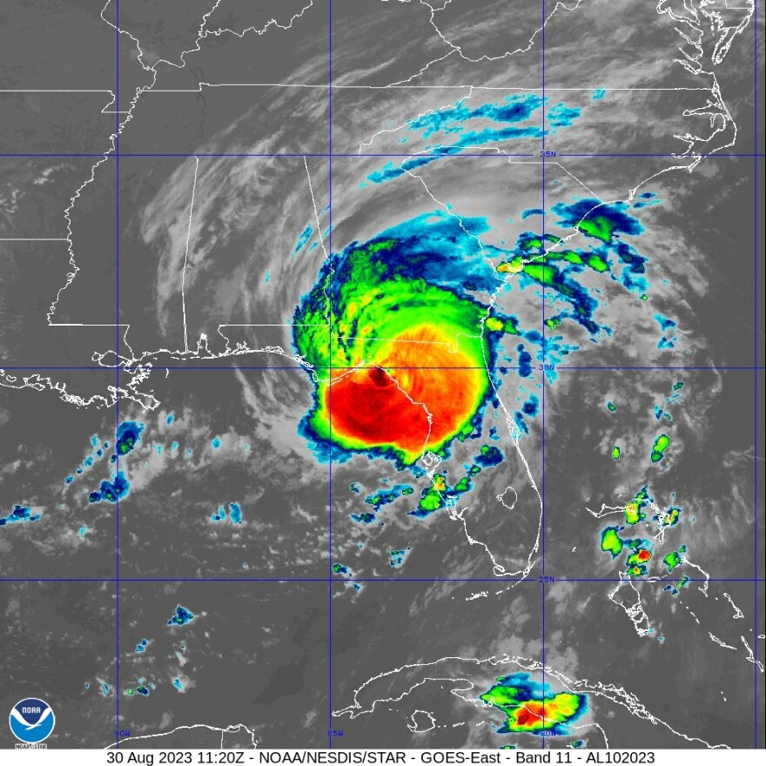
AASHTO CTSO Annual Meeting August 27 – September 1, 2023 Orlando, FL Did Not Happen
Hurricane Idalia

Slide 4
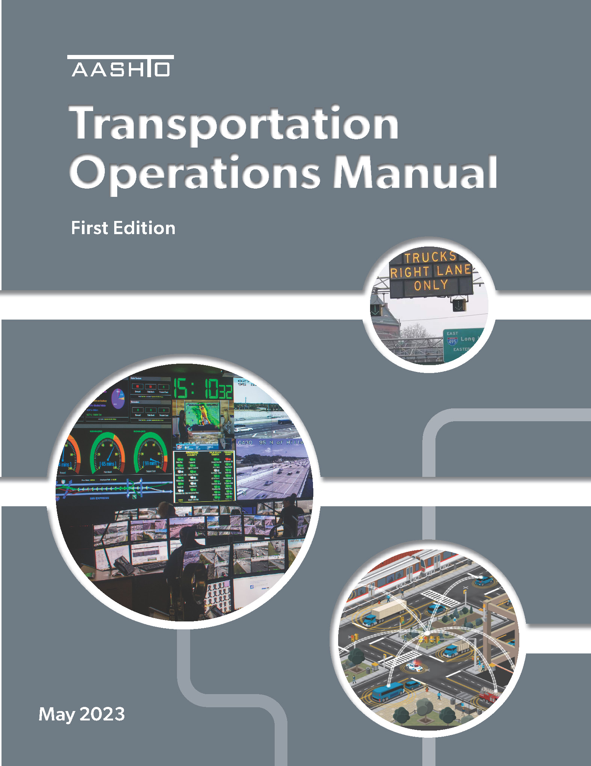
AASHTO Traffic Operations Manual
First Edition published May 2023
Electronic only
30 chapters, ~640 pages
6 Sections: “All Things TSMO”
A: Introduction
B: TSMO Concepts and Context
C: TSMO Program Development & Management
D: Project Development
E: Tactical Elements
F: Industry & Technology Trends
Overseen by TOM Technical Committee (revisions, updates, marketing, etc.) (Dave Huft a member)

Slide 5
AASHTO Traffic Operations Manual
TOM Chapters Review Focus Subcommittee on Freight Operations
1 | Introduction
2 | TSMO Concepts
3 | TSMO in the Transportation Agency Context
4 | Agency Readiness to Advance TSMO
23 | Freight Operations
29 | Technology Trends

Slide 6
Issues Related to Emergency Movements
Final Rule on Declared Emergency Safety Regulation Waivers
FMCSA published October 13
Limits Governor-declared emergencies
Reduces maximum duration from 30 days to 14; only FMCSA can extend
Exempts only Hours of Service provisions, not other safety provisions
Comments due by November 13
Emergency Movement of Divisible Overweight Loads on Interstate Highways
Freight Operations Subcommittee supports allowing Governors to declare emergencies to trigger the Stafford Act
Also supports expanding emergency definition beyond natural disasters
No legislation

Slide 7
Issues Related to Emergency Movements
Memorandum of Understanding to Establish Common Weight Allowance
Mid America Association of State Transportation Officials (MAASTO) MOU
Adopted late 2021
Allows 10% allowance for overweight divisible loads on Interstate highways in all states during declared emergencies
The Eastern Transportation Coalition is working to adopt in the northeast (NASTO) and southeast (SASHTO) regions
WASHTO needs to pursue a similar agreement
Largest number of states
Largest geographic area
Clear benefit to industry and states

Slide 8
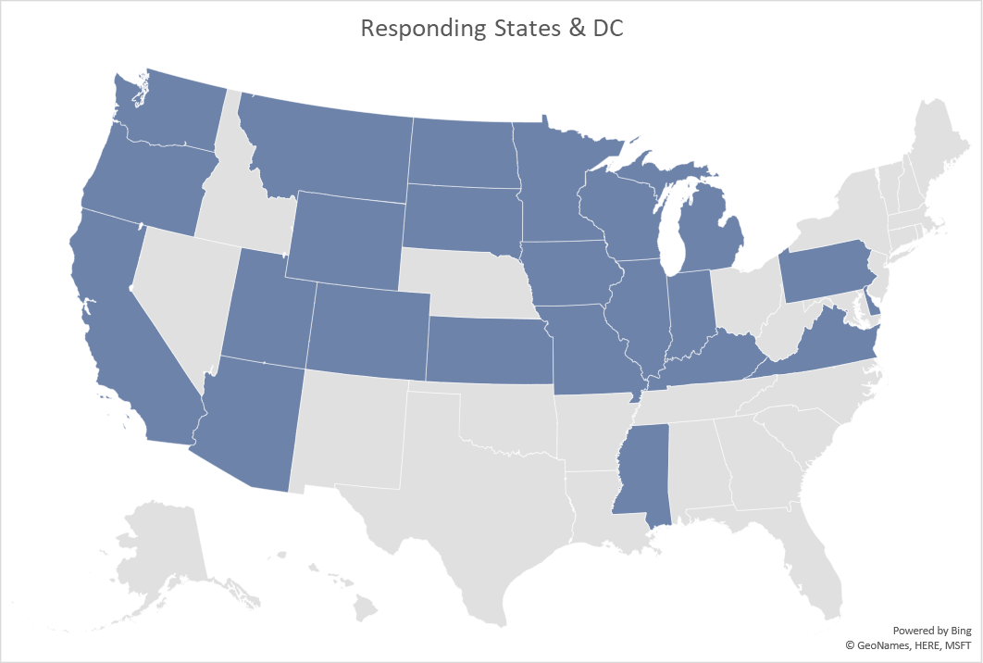
Freight Operations Subcommittee Legislative Proposal Survey 2023
SHIP-IT ACT

Slide 9
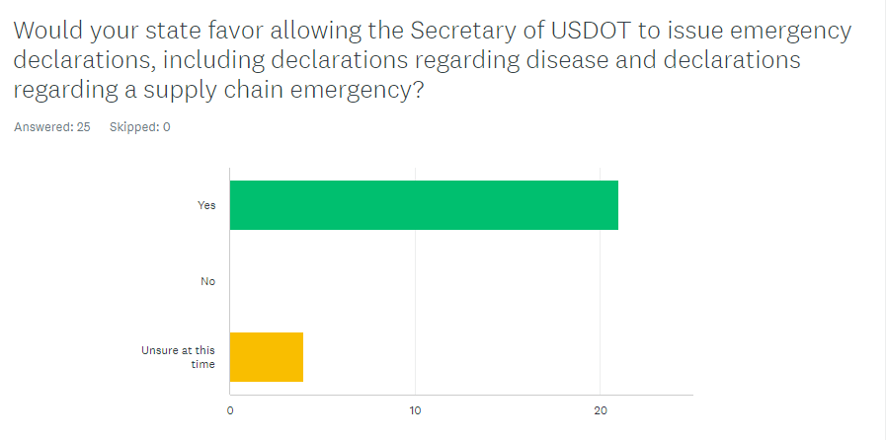
Comments
Strongly supported
Expect quicker decisions
States want to retain authority to issue permits

Slide 10
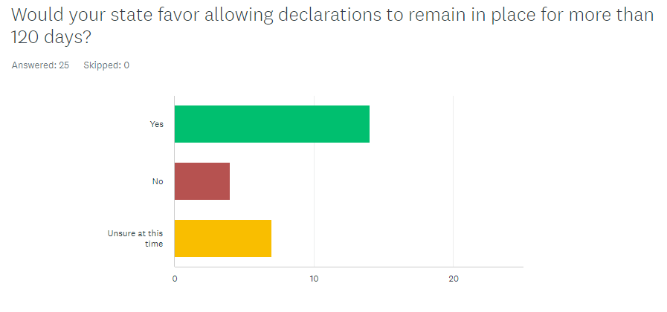
Comments
Mostly supported
Recognized need for longer declarations
Some concern about over-extending declaration period
Some suggested review for longer declarations

Slide 11
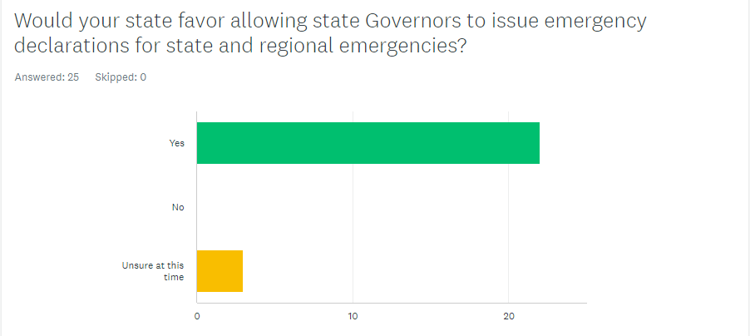
Comments
Strongly supported
Recognized need for local declarations
Some concern about potential for abuse

Slide 12
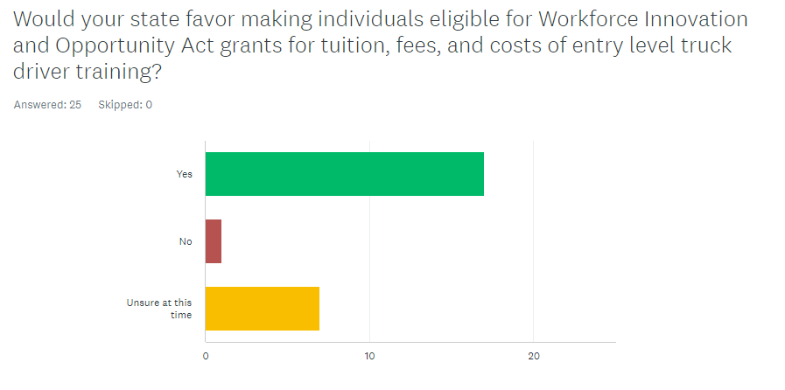
Comments
Mostly supported
Recognition of driver shortage
Not necessarily DOT area of responsibility
Could require administrative effort

Slide 13
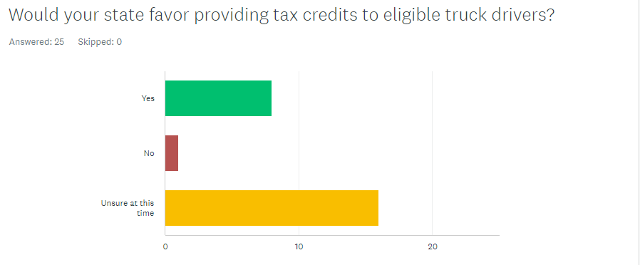
Comments
Mostly supported
Recognition of driver shortage
Not necessarily DOT area of responsibility

Slide 14
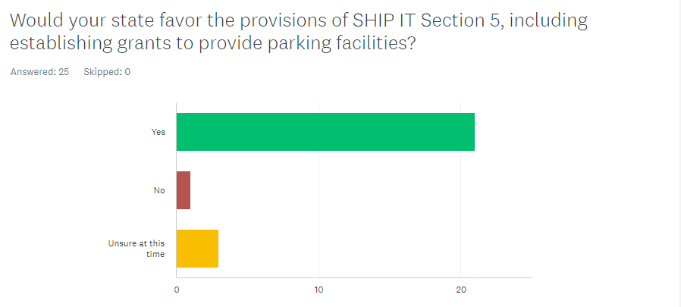
Comments
Strongly supported
Recognition of truck parking shortage
Some concern whether parking is a public or private responsibility
Some concern about long-term maintenance

Slide 15
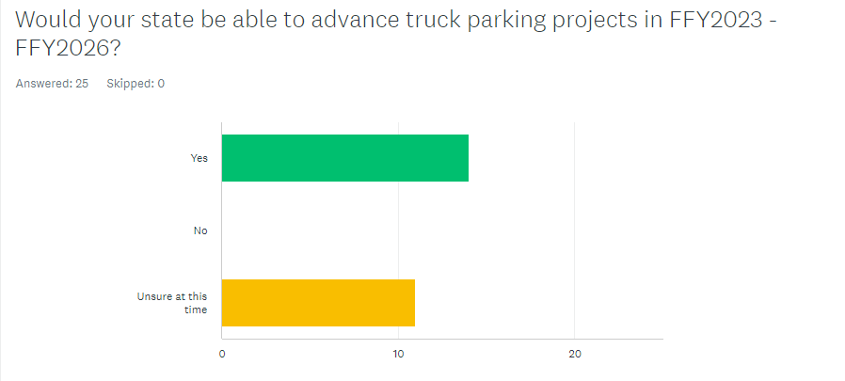
Comments
About half of states said they can build or at least design
Concern about the length of project development process

Slide 16
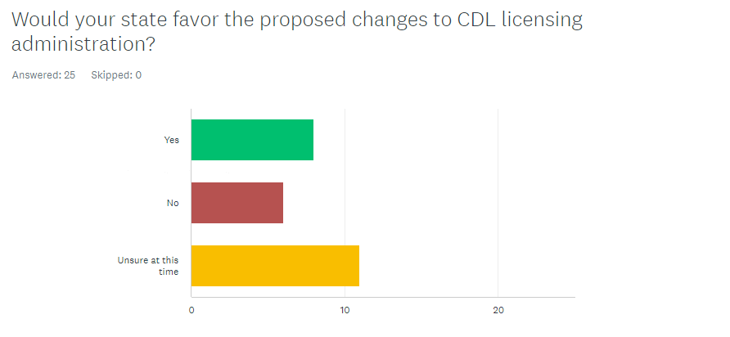
Comments
Mixed opinion
Some states are trying
Not necessarily DOT area of responsibility
Concerns about administrative load and process changes

Slide 17
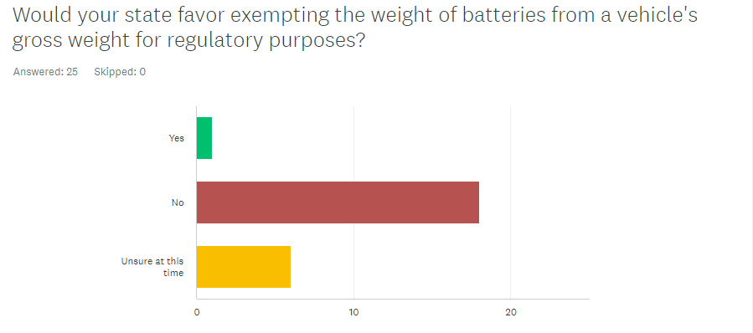
Comments
Strongly opposed
Recognition of move to electric vehicles
Strong concern about effects of load on pavements and bridges

Slide 18
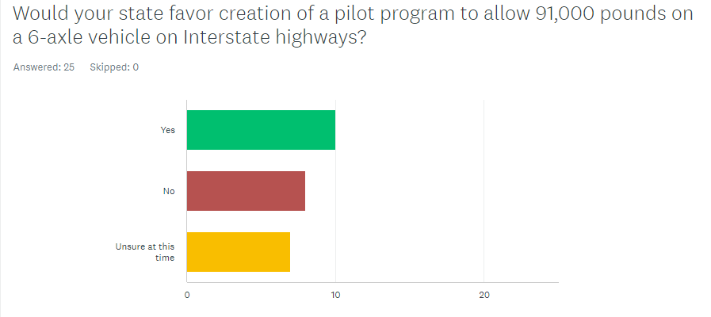
Comments
Mixed opinion
Some states already allow
Some concern about effects of load on pavements and bridges
Mixed understanding of ESALs
Concerns about non-uniformity among states

Slide 19
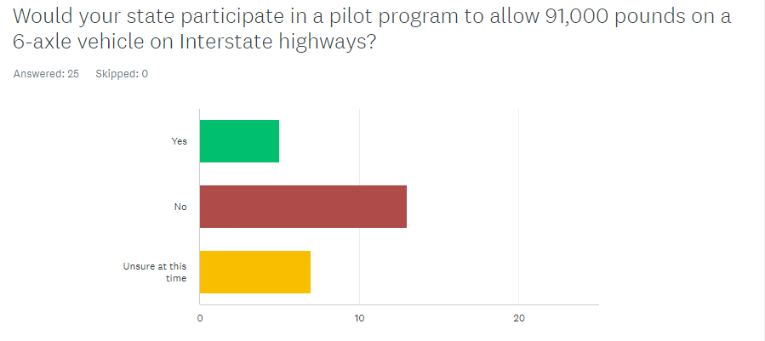
Comments
More “No” than “Yes”
Some states already allow
Concerns about permitting and reporting burden

Slide 20
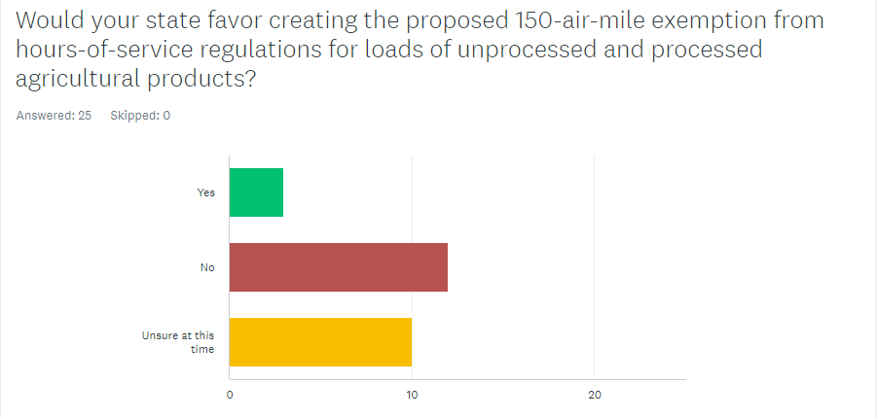
Comments
Mostly opposed
Definition of agricultural products far to broad, especially “processed”
Concern about determining haul distance

Slide 21
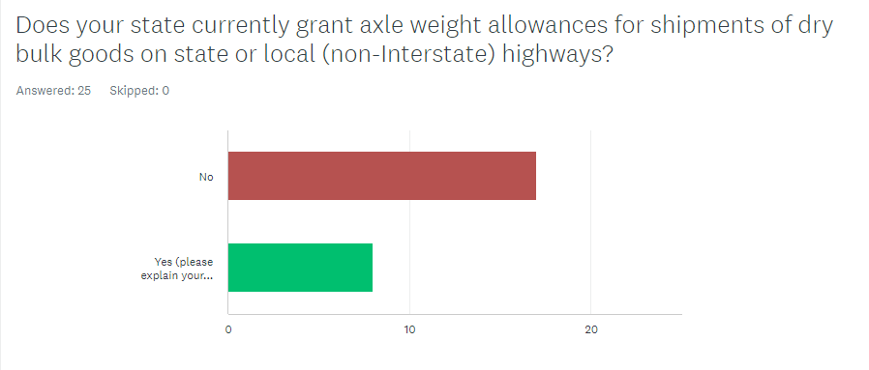
Comments
Not in SHIP-IT (separate)
Most states do not grant allowances
Many feel existing weight tolerances accommodate
Concerns about effects of load on pavements and bridges

Slide 22
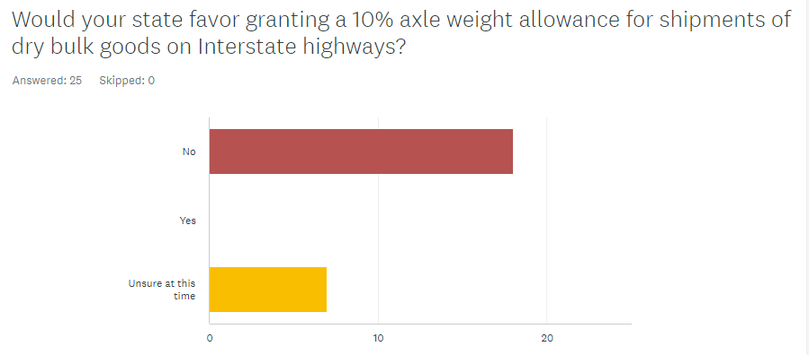
Comments
Strongly opposed
Many feel existing weight tolerances accommodate
Concerns about effects of load on pavements and bridges
Some concern about broad range of commodities

Slide 23
Specialized Transportation Symposium
Specialized Carriers & Rigging Association
AASHTO Freight Operations Subcommittee
Regional Highway Transport Committees
Westin Gallery, Houston TX
February 20 – 22, 2024

Slide 24
Freight Operations Subcommittee Web Meeting November 14, 12:00 – 1:30 Mountain Time
Welcome and Operating Remarks
FHWA Briefing
AASHTO and TOM Updates
Permitting of Emergency Loads
FMCSA Final Rule
Federal Legislation to Authorize Governors to issue Emergency Declarations
Regional Memoranda of Understanding on Emergency Weight Limits
2024 Specialized Transportation Symposium agenda planning**
Q&A Roundtable
Click here to join the meeting

Slide 25
NCHRP Research
NCHRP 08-139: Methods to Prevent Bridge Strikes by Trucks/Bridge Strike Challenges, Prevention, Mitigation Strategies and Best Practices
NCHRP 23-25: Interstate Information Sharing of State Truck Regulatory Requirements
NCHRP 20-05: Synthesis Topic 51-12 Night and Weekend Movement of OS/OW Loads
NCHRP 23-13(03): Guidance for State DOTs on Truck Rest and Service Areas for Critical Supply Chain Delivery
NCHRP 23-13(05): Relaxation of Truck Weight Restrictions for Emergency Deliveries
NCHRP 08-140: National Design and Interoperability Standards for Truck Parking Information Management Systems
NCHRP 08-141: Guidance for Local Truck Parking Regulations
NCHRP 20-05: Synthesis Topic 54-13 Truck Escape Ramp Design and Operation
NCHRP 17-121: Using Advanced Technologies to Reduce Commercial Motor Vehicle Crashes in Work Zones
Notes:
Discussion of topics on this slide will be led by Dave Huft

Slide 26
Contact Information
Questions?
Contact
Dave Huft, Co-Chair
Dave.Huft@state.sd.us
Geno Koehler, ILDOT, Co-Chair
Geno.Koehler@illinois.gov

