Slide 1
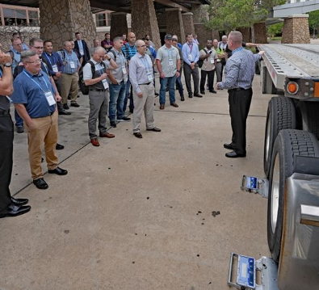
CVSA Update on Size & Weight
Jackie Darr
Brad Marten –Size and Weight Chair
Denver, CO
Oct 31, 2023
Photo credit CVSA Facebook Page

Slide 2
Agenda
New Business
International Society for Weigh-in-Motion
Gave basics on Wims, Will be a Webinar and in Person conference
FHWA-Update –Mike Latuszek
State Plans – looking at changing to 3 years
Milk- Talked about as a non-divisible load
Non-divisible load Update – Jackie
Looked at a frac pump with a gas tank
Showed what ND is using for enforcement/permitting

Slide 3
Agenda continued
Re-Authorization Task Force Weight Proposals-Brad Marten
CVSA Task force -Size and Weight
Non-divisible milk was the issue
Clearer guidance on weight with natural gas & propane
MCSAP Funding - where can we use it trying to expand
Michigan State Police - Legal weights- Lt Chris Keller
Discussed legal weights on truck and what state of Michigan allows
No gross weight just axle and length limits stuck at 169,000
Weight & Balance /Tires Intercomp
Discussed weights on the split scale
Inner tire generally heavier

Slide 4
Agenda- Continued
Live Demo of Split scale
Kendall Jackson & Patrick McIntyre hands on
Roundtable discussion- Items from states

Slide 5
Contact Information
Brad Marten –
Montana Department of Transportation
bmarten@mt.gov
Jackie Darr
North Dakota Highway Patrol
jdarr@nd.gov

